Slide 1
Notes:
Thank you for inviting me to speak at
Thank you to your active members who serve on Divisions, Committees, Subcommittees and elected bodies.
It is my honor to speak to you today about IUPAC…

Slide 2
IUPAC Presentation
2018

Slide 3
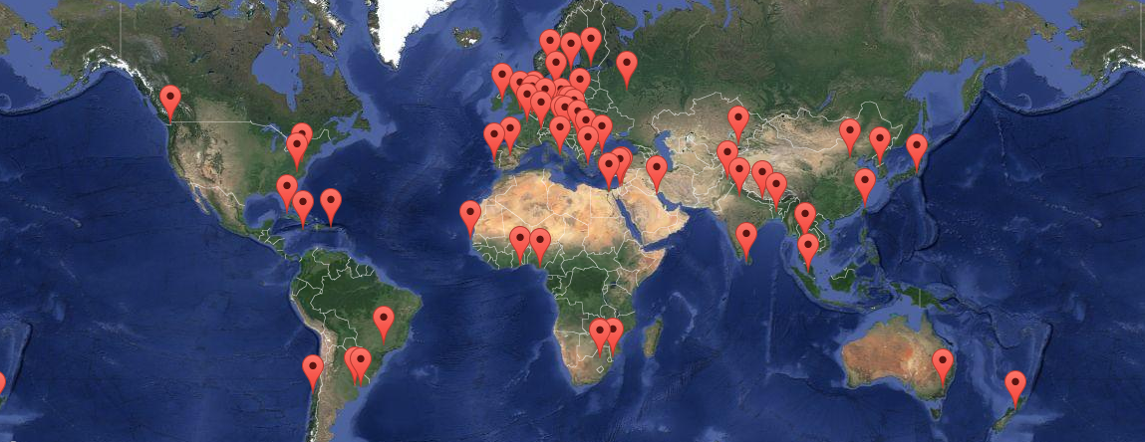
2018-2019 IUPAC Member Nations (57) Governance of the Union

Slide 4
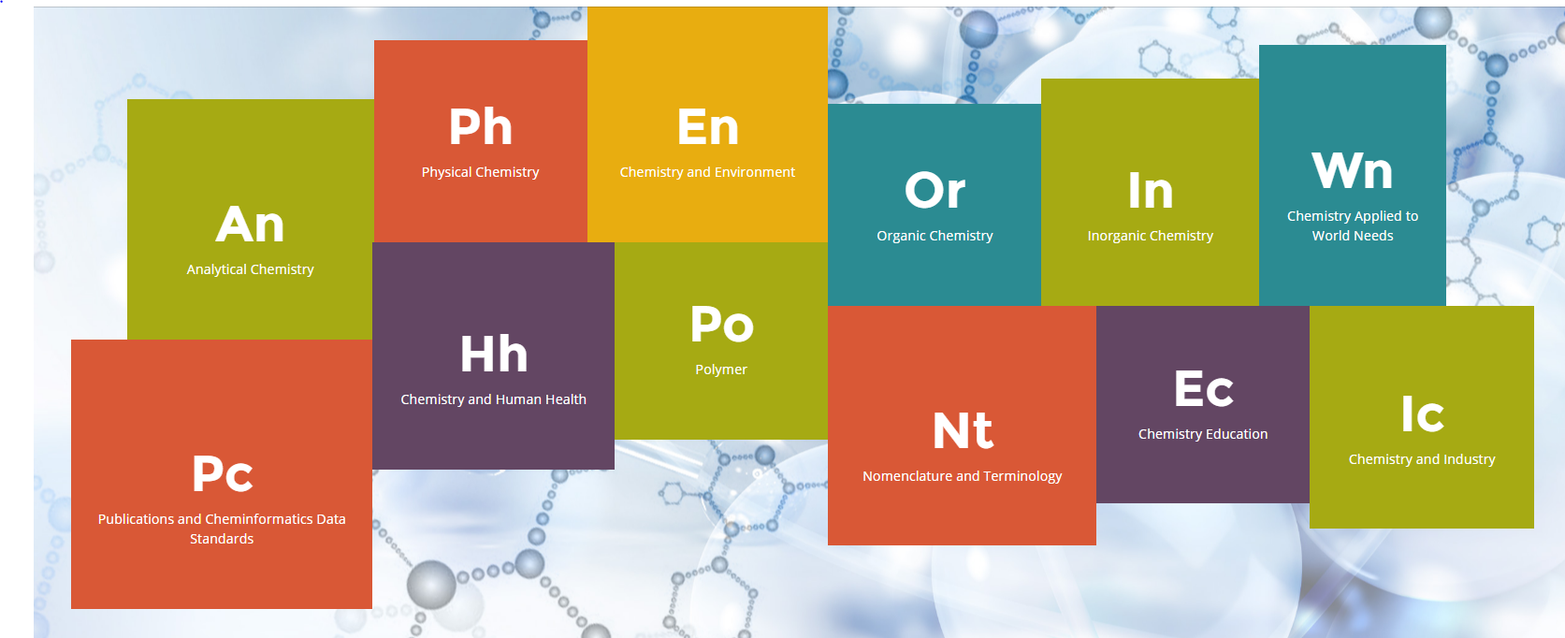
Scientific Work of IUPAC Fields of Study
Notes:
The fields of Chemistry and focus areas of IUPAC’s volunteers

Slide 5
IUPAC’s Scientific Work Divisions and Standing Committees–
Physical & Biophysical Chemistry
Inorganic Chemistry
Organic & Biomolecular Chemistry
Polymer Chemistry
Analytical Chemistry
Chemistry & the Environment
Chemistry & Human Health
Chemical Nomenclature & Structure Representation
Committee on Chemistry and Industry (COCI)
Committee on Chemistry Education (CCE)
CHEMRAWN Committee
Committee on Publications and Cheminformatics Data Standards (CPCDS)
Interdivisional Committee on Terminology, Nomenclature and Standards (ICTNS)
Interdivisional Committee on Green Chemistry for Sustainable Development (ICGCSD)
Notes:
Or, in a traditional format, the list…I prefer to use the Fields of Chemistry from the website, so that people know where they can look quickly at all that IUPAC does.

Slide 6
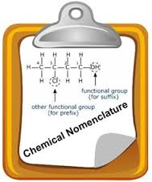
Primary IUPAC Activities
Development of the Language of Chemistry
Nomenclature, Symbols, Terminology
Standardization of Chemistry Methods
Data Presentation
Study of Analytical Methods
Critical Evaluation of Physico-Chemical Data
Atomic Weights
Thermodynamic Data
Kinetic Data

Slide 7
Primary IUPAC Activities (Cont.)
Data Exchange Standards for Computers and Instruments
Endorsement of International Conferences
Biennial IUPAC Congress
San Juan, Puerto Rico (2011), Istanbul, Turkey (2013), Busan, Korea (2015), Sao Paulo, Brazil (2017), Paris, France (2019)
More than 30 Specialized Symposia each Year
Chemistry Education
Industrial Safety and Environmental Programs
CHEMRAWN Conferences addressing Chemistry and World Needs
Notes:
Too much text on this slide.

Slide 8
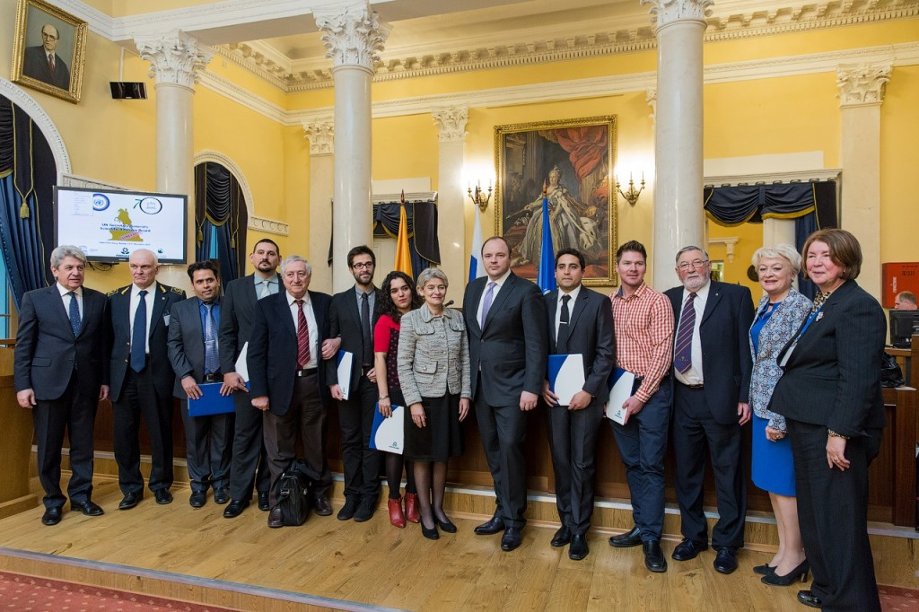
IUPAC operates a Project system
Anyone with a good idea can submit a project proposal.
IUPAC project funding is to facilitate the work of volunteers
Highly leveraged (total IUPAC annual budget only $1.25 M)
We have and accept funding in support of this work but retain scientific responsibility e.g.:
IUPAC-Solvay Prize for Young Chemists
PhosAgro Green Chemistry awards (UNESCO)
Safety Training Program
International Year of Chemistry 2011
IUPAC Centenary 2019
Notes:
Possible image for this information? Reduce text?

Slide 9
Proposals for Projects
IUPAC projects address issues of significance to the general chemistry community:
Nomenclature, terminology, and symbols
Validated and compiled data
Standard methods and procedures
Education and public understanding of chemistry
Any subject that requires development of consensus among chemists worldwide
More information: www.iupac.org/projects

Slide 10
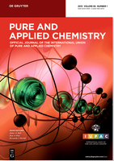
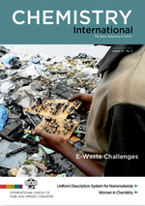
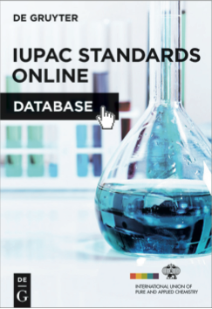

Results- IUPAC’s Publications
Pure and Applied Chemistry (PAC)
Chemistry International (CI)
IUPAC Standards Online (2016)
Responsible Care Manual

Slide 11
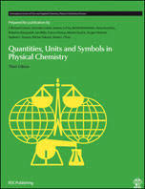
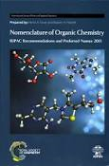
Results- IUPAC’s Color Books
Chemical Terminology | Gold Book
Quantities Units and Symbols in Physical Chemistry | Green Book
Nomenclature in Organic Chemistry | Blue Book
Compendium of Polymer Terminology and Nomenclature | Purple Book
Analytical Terminology | Orange Book
Biochemical Terminology | White Book
Nomenclature in Inorganic Chemistry | Red Book
Compendium of Terminology and Nomenclature of Properties in Clinical Laboratory Science | Silver Book

Slide 12

IUPAC Membership Programs
National Adhering Organizations-Are the Governing bodies (Council) of IUPAC
Associate National Adhering Organizations
Observer Status-Chemical councils, Chemical Societies, National Academies and institutions representing national chemical interests
Associated Organizations
International organizations that share common goals and interest with IUPAC.
Company Associates
Industrial companies, research and development institutions can associate through the program
Individual Members
Membership for individuals, coordinated by NAOs, Societies or directly with IUPAC

Slide 13
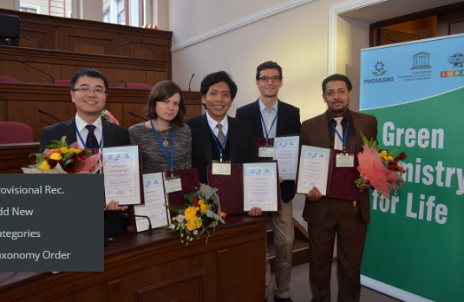
Scientific Awards Programs
IUPAC-Solvay International Award for Young Chemists
PhosAgro/UNESCO/IUPAC Green Chemistry for Life Grants Program
DSM Materials Sciences Award
Distinguished Women in Chemistry or Chemical Engineering
Hanwaha-Total IUPAC Young Scientist Award
ThalesNano Prize for Flow Chemistry
CHeMRAWN VII Prize for Green Chemistry
Polymer International-IUPAC Award
IUPAC International Award for Advances in Crop Protection Chemistry
https://iupac.org/category/awards/

Slide 14
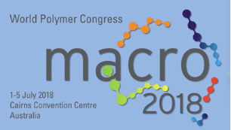
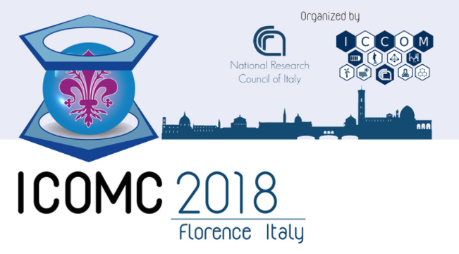
IUPAC Endorsed Conferences/Events
Notes:
Conferences are endorsed by IUPAC through a rigorous review process to insure that they meet IUPAC’s expectations. Held in our NAO countries. We also provide financial support through our Financially Supported Conference program in emerging regions and emerging chemistry fields.

Slide 15
IUPAC Current Interests
Notes:
Where is IUPAC focusing for the future???

Slide 16
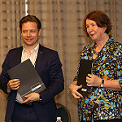
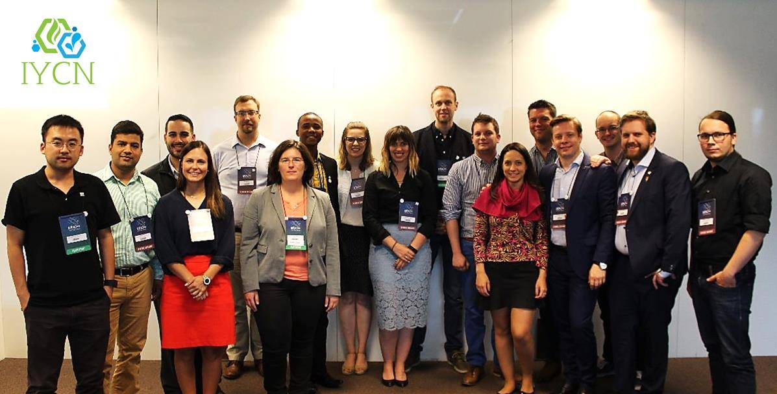

Building the Future
International Young Chemists’ Network
Approved by Council as Associated Organization of IUPAC
MOU formalized in Brazil in July 2017
Participation in WCLM 2017

Slide 17
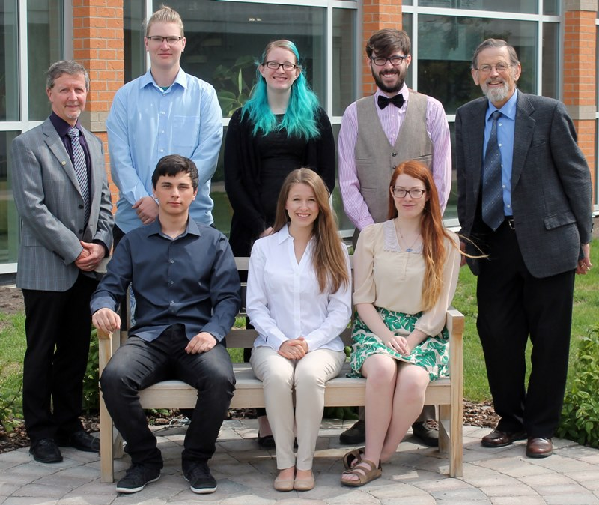
Encourage and Mentor the Best and Brightest for the Future Collaboration on Global Scale for Success
and background, recruited by transparent and well-understood processes.
Young Chemists
IYCN
Young Observers

Slide 18
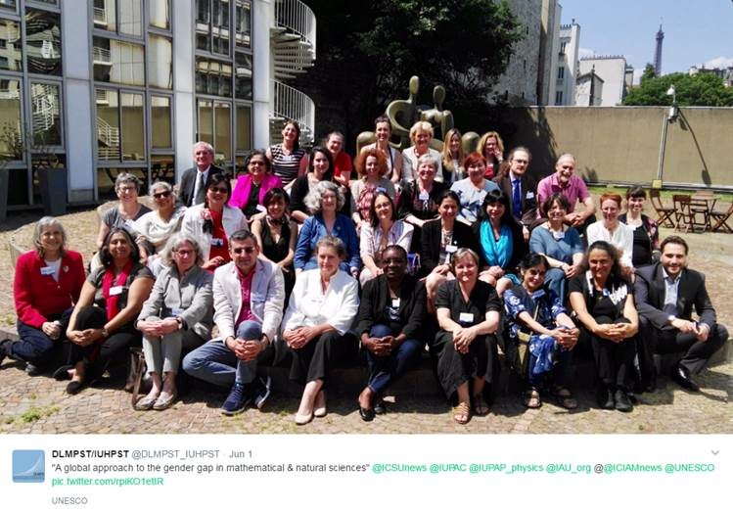
Committee on Chemistry Education
“A Global Approach to the Gender Gap in Mathematical and Natural Sciences: How to measure it, How to reduce it?”
Joint Project between International Mathematical Union and IUPAC
Funding: International Council for Science (ICSU)
Three year grant: € 100,000

Slide 19

IUPAC Issues for Today UN Sustainable Development Report
ADVANCING CHEMISTRY WORLDWIDE
UN call for projects in support of its Sustainable Development Goals Q1 2017
IUPAC project to address this
Creation of an Interdivisional Committee on Green for Sustainable Chemistry approved (ICGCSD)

Slide 20
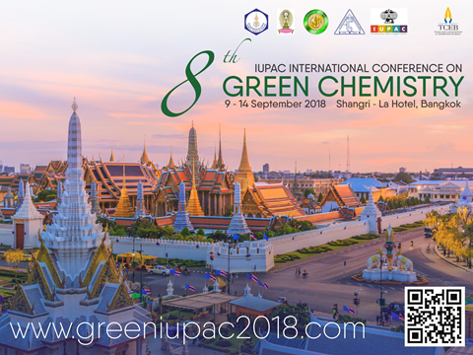
Green Chemistry: Education, Outreach and Conference Series
Post-Graduate Summer School Program
Focus on Younger Chemists (<35)
2019 Proposal: Tanzania
ChemRawn VII Prize in Green Chemistry
International Conference on Green Chemistry
Interdivisional Committee on Green Chemistry for Sustainable Development (ICGCSD)

Slide 21
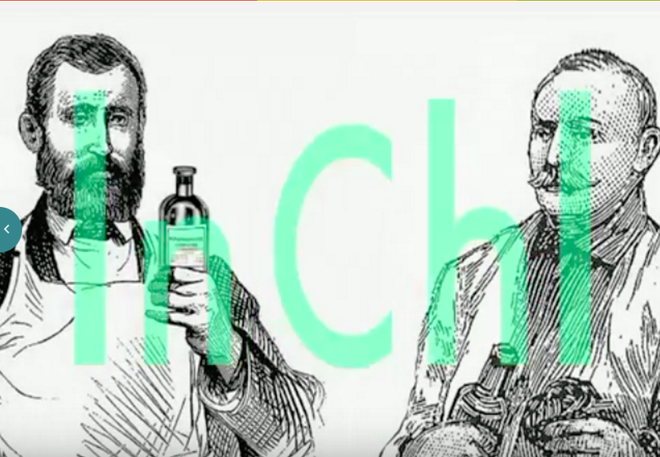



IUPAC Issues for Today Big Data, Data Sharing, Standards & Machine Exchange
ADVANCING CHEMISTRY WORLDWIDE
http://www.inchi-trust.org/
Project: 2015-019-2-800
QR Codes
IUPAC International Chemical Identifier (InChITM)
http://www.icsu.org/science-international/accord
ICSU Big Data

Slide 22

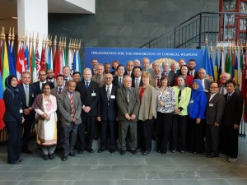

IUPAC Issues for Today OPCW Ethical Guidelines
ADVANCING CHEMISTRY WORLDWIDE
IUPAC Endorsed
The production and use of chemicals is accompanied by recognition of the responsibility of chemists to ensure that they are applied solely for peaceful and beneficial purposes.
https://www.opcw.org/special-sections/science-technology/the-hague-ethical-guidelines/

Slide 23

IUPAC Issues for Today Strategic Approach to International Chemicals Management (SAICM)
Is a policy framework to promote chemical safety around the world.
Key Initiative by UN through UNEP and WHO
IUPAC sees a role for an authoritative, independent, science input
Currently reviewing IUPAC projects on green and sustainable chemistry as an input and reviewing the international chemistry approach to the new UN Sustainable Development Goals.
Seeking an efficient way to engage in SAICM process
Represented by Anna Makarova, Mendeleyev University of Technology

Slide 24
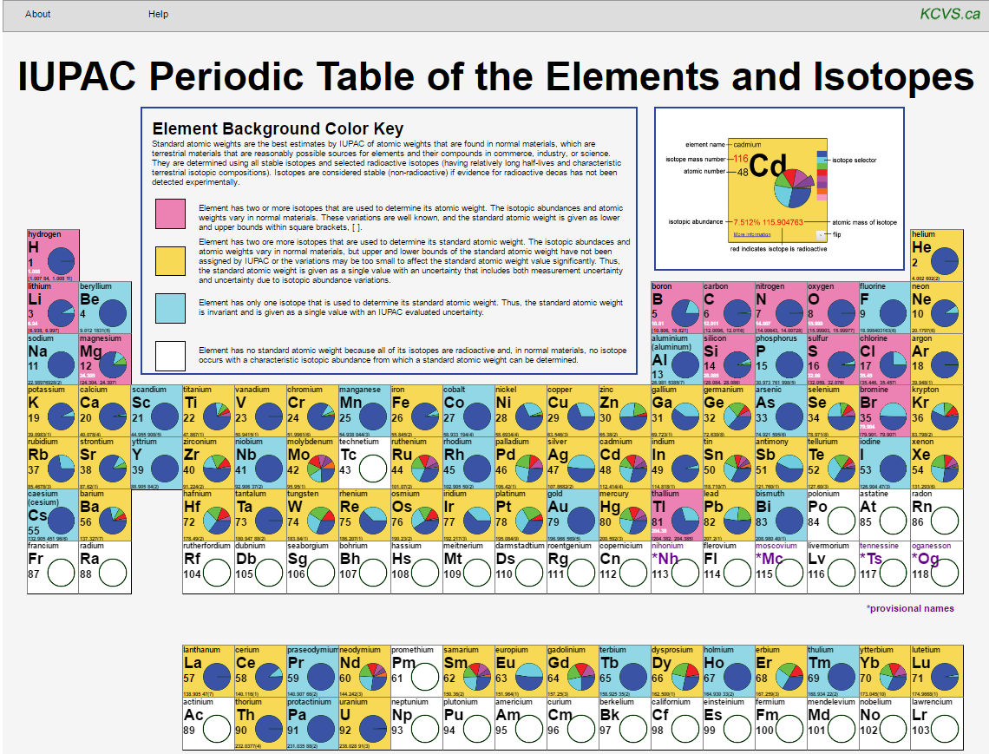

IUPAC Issues for Today Bringing Science and Education Together
Peter Mahaffy/Norman Holden
www.isotopesmatter.com

Slide 25
Responsible Care in Africa
ADVANCING CHEMISTRY WORLDWIDE
Initiative of Chemical Industry (ICCA)
IUPAC partnering with ICCA/UNEP/OPCW
IUPAC Responsible Care book (tertiary education)
IUPAC Safety Training Programme
Educational programmes/ Pan African Network
IUPAC participation in SAICM

Slide 26
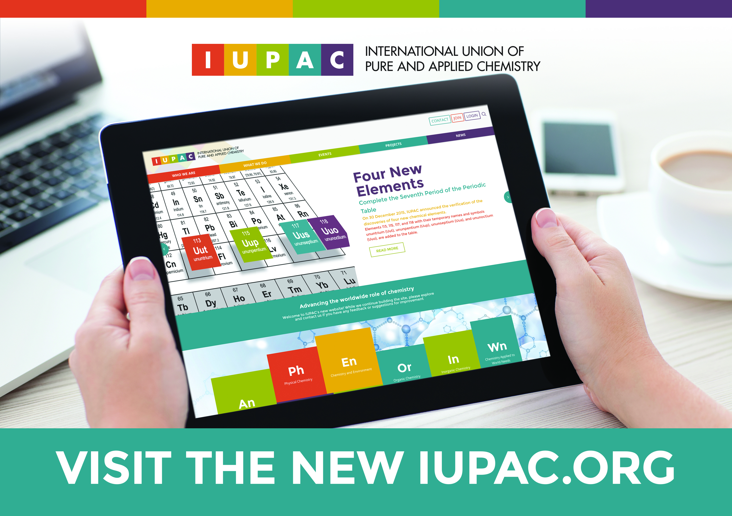
Connect with us and learn more at www.IUPAC.org
Current IUPAC Projects
Member Directory
Reports and Recommendations
Chemistry International eTOC
Conference and Events Calendar
Nomenclature and Terminology
Governance

Slide 27
Backup Slides for Use

Slide 28
Who We Are

Slide 29
IUPAC is an indispensable resource for chemistry.
Notes:
In 2015, a Strategic Plan task group was formed and has led to an updated Strategic Plan for IUPAC. The mission, vision, Core Values and our Unique role in the World Chemistry community was developed.

Slide 30
The International Union of Pure and Applied Chemistry is the global organization that provides objective scientific expertise and develops the essential tools for the application and communication of chemical knowledge for the benefit of humankind and the world.

Slide 31
The International Union of Pure and Applied Chemistry accomplishes its mission by
Fostering sustainable development
Providing a common language for chemistry
Advocating the free exchange of scientific information

Slide 32
CORE VALUES
We serve humankind by advancing chemistry worldwide.
Scientific excellence and objectivity are the cornerstones of all of our work.
We value collaboration and communication among all our stakeholders.
We strive for diversity and inclusiveness.
We respect each other and the Union
We uphold the highest standards of transparency, responsibility and ethical behavior.
Notes:
The core values provide the foundation of the strategy. They are principles that guide the conduct of the Union and its relationships with its stakeholders. IUPAC’s core values emphasize scientific excellence, communication, transparency, diversity, and ethical behavior. These behaviors are expected to be practiced by all of the Union’s volunteers, staff and stakeholders.

Slide 33
IUPAC’s unique role in the world chemistry community
• A focus on those aspects of chemistry where global consensus is essential for progress in research, commerce and policy.
• Respect for its objectivity and scientific excellence, providing access to the highest levels in the scientific, industrial, and policy communities to represent global chemistry.
• A worldwide base of volunteers with the best skills and background, recruited by transparent and well-understood processes.
Notes:
The task group articulated IUPAC’s unique role in the world chemistry community as follows:
A focus on those aspects of chemistry where global consensus is essential for progress in research, commerce and policy.
Respect for its objectivity and scientific excellence, providing access to the highest levels in the scientific, industrial, and policy communities to represent global chemistry
A worldwide base of volunteers with the best skills and background, recruited by transparent and well-understood processes.
IUPAC’s unique role in the worldwide chemistry community summarizes its value to its Members and stakeholders. IUPAC, with its global reach, can effectively convene the chemistry community through its Members and volunteers to address global needs through the contributions from the chemical sciences.

Slide 34
How we do it

Slide 35
What we do

Slide 36
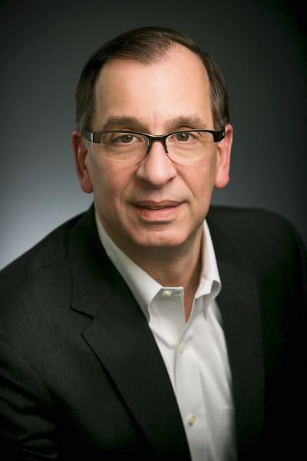
IUPAC-Richter Prize in Medicinal Chemistry
Established in 2006. Acknowledges the key role that medicinal chemistry plays toward improving human health
$ 10,000 awarded every two years to an internationally recognized scientist whose accomplishments demonstrate an outstanding level of contribution to the practice of medicinal chemistry or drug discovery.
2016 Prize was awarded (01 March 2016) to
Michael J. Sofia, Ph.D. In recognition of
outstanding contributions to the invention,
discovery and development of the novel
antiviral drug sofosbuvir (SovaldiTM)
as a treatment for the cure of hepatitis C.

Slide 37
IUPAC Responsible Care Book
The context and history of the development of Responsible Care
The Core Principles and why these are as relevant today and for the future
The benefits and challenges of implementing Responsible Care
Two Case Studies:
The benefits and challenges of successful implementation in Sulco Chemicals Ltd Canada
Responsible Care in the chemical supply chain – avoiding tragedies such as occurred in cough mixture in Haiti

Slide 38
IUPAC Safety Training Program (STP)
An HSE capacity building program
Voluntary agreement of companies to train influential individuals from developing countries
Objectives
To promote interactions between developed countries and the developing world
To disseminate state-of-the-art knowledge on safety and environmental protection in chemical production and use.

Slide 39
STP FELLOWS SINCE 2000
2000 Ms. Esma Toprak Bogazici University Istanbul BP Chem. USA
Prof. El-Emam Mansoura University Cairo Bristol-Myers USA
2002 Mr, Tersoo Gwaza Shell Petrochem Nigeria SASOL SA
Mr. Guohong Zhang SINOPEC China BP Chem USA
Mr. Kelvin Khisa UNIDO Nairobi Sankyo Japan
2003 Ms. Jane Nyakang'o UNIDO Nairobi BP Chem USA
Ms. Luisa Arocena CEMPRE Uruguay BP Chem USA
2004 Mr. Bakare Isiaka Rubber Institute Nigeria Mitsui Chem Japan
2005 Prof. S Bayomi Mansoura University Cairo AstraZeneca UK
2007 Prof. Fabian Benzo Montevideo University Uruguay Mitsui Chem. Japan
Dr. Godfred Nyarko Tema Lube Oil Co. Ghana Mitsui Chem. Japan
2008 Dr. Gursharn Grover National Research Council India Novozymes Denmark
2013 Prof. Jonathan Babalola Ibadan University Nigeria Dow Benelux
Mr. John Mumbo Environment Authority Kenya Dow Benelux
2014 Eng. Noha Elbalky FEI-ECO Cairo Woodbridge Canada
2015 Prof. Ahmed Youssef Cairo University Cairo Bayer Crop Science USA
Ms. Christine Ashaolu Regulatory Agency Abuja Nigeria National Silicates Canada

Slide 40
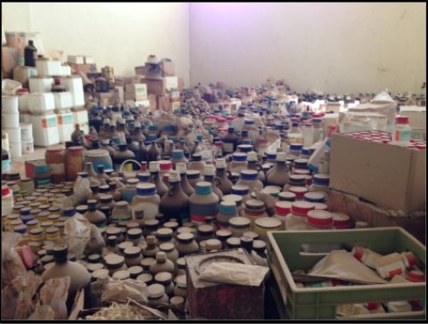
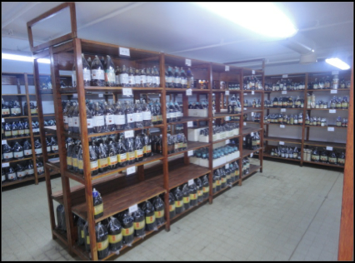
Professor Youssef project Chemicals storage in North African Universities
After
Before

Slide 41

The IUPAC Secretariat Research Triangle Park, North Carolina
Notes:
The Secretariat Staff supporting the work of IUPAC’s volunteers, from left to right: Dr. Lynn Soby (Executive Director), Jay Lucido (Financial Controller), Enid Weatherwax (Administrative Assistant), Linda Tapp (Membership Manager) and Dr. Fabienne Meyers (Associate Director and Managing Editor for Chemistry International)

Slide 42
Thank you for Advancing Chemistry World Wide with IUPAC

Slide 43
Encourage and Mentor the Best and Brightest for the Future and Collaboration on Global Scale
and background, recruited by transparent and well-understood processes.
Young Chemists
IYCN
Young Observers
Notes:
Call to Action: (LMS)
worldwide base of volunteers with the best skills and background, recruited by transparent and well-understood processes.

