Slide 1
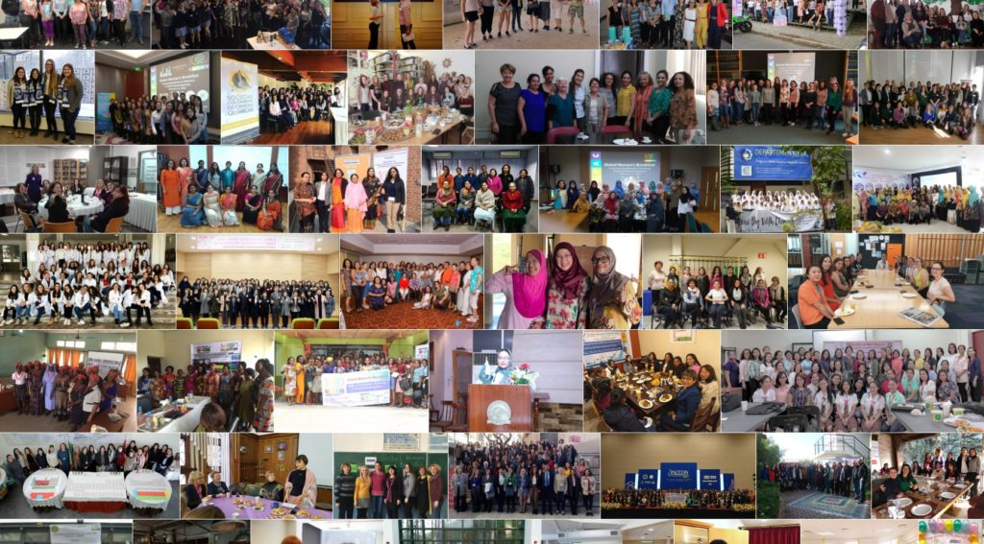
Global
Women’s
Breakfast
2020

Slide 2
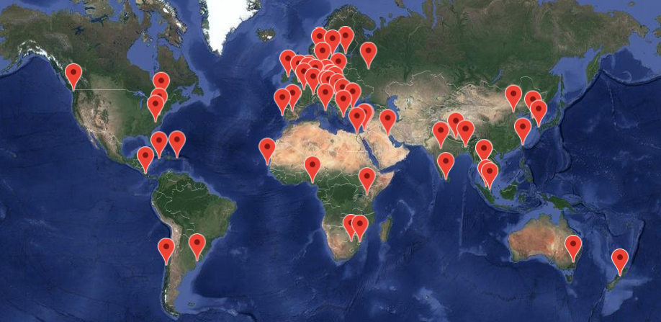
IUPAC is the global union of chemistry organizations
Notes:
IUPAC is the globally recognized union of chemistry organization. It is often described as the United Nations of Chemistry. The Union is made up of Nations or National Adhering Organizations. It is also made up of other associated organizations, company associates, and yes, individual affiliate members.

Slide 3
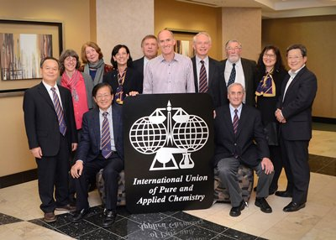
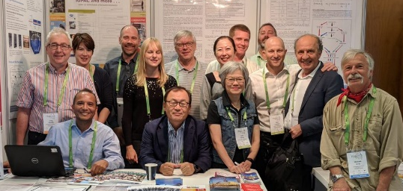
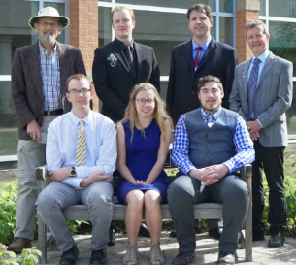
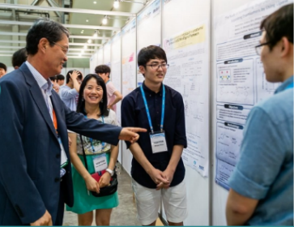
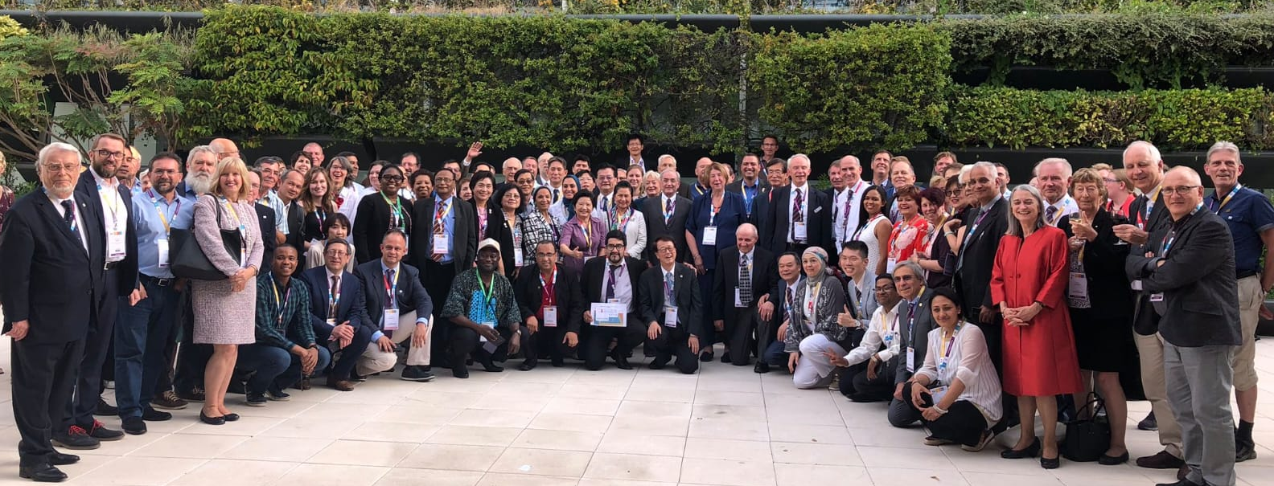
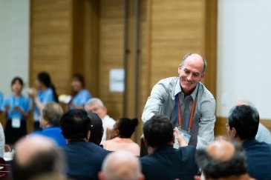
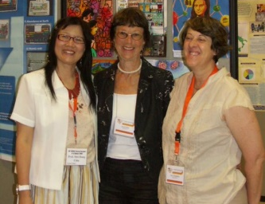
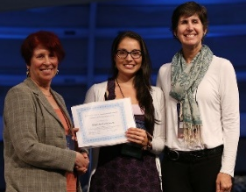
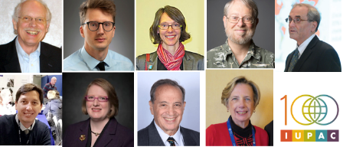
IUPAC is fueled by 1000s of volunteer experts
Divisions:
Analytical
Physical
Environment
Human Health
Polymer
Organic
Inorganic
Nomenclature & Terminology
Notes:
IUPAC does its work through a series of divisions and committees. But what really fuels IUPAC are the thousands of volunteer experts who provide their expertise. These experts are supported by a small but dedicated staff at the IUPAC secretariat in Research Triangle Park, North Carolina.

Slide 4
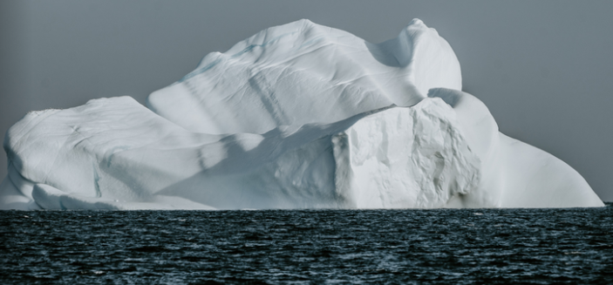
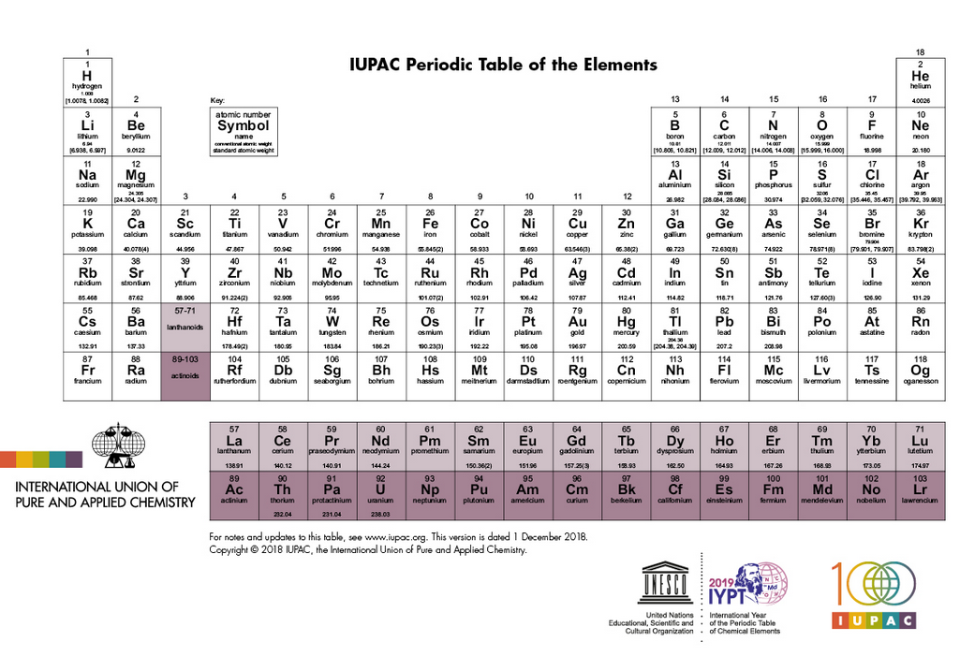
IUPAC is like an iceberg – much of it is under the surface
Big Data Standards
Nomenclature
Digital identifiers for molecules
Atomic Weights
Units and Terminology
Mole and Kilogram
Naming of new elements
Free Exchange of Scientific Information
Notes:
One of our IUPAC volunteers was recently quoted as saying, “IUPAC is like an iceberg – most of it is under the surface”. It’s true. Many people don’t know anything about IUPAC, but the impact of IUPAC on the scientific community is enormous. IUPAC provides those fundamental tools that all scientists need to effectively do their work and to effectively work with each other to advance their field of science.

Slide 5

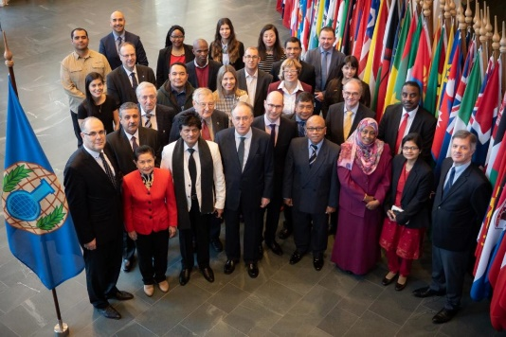

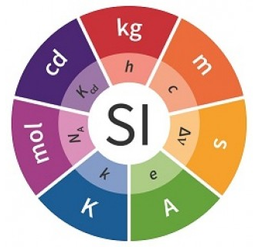
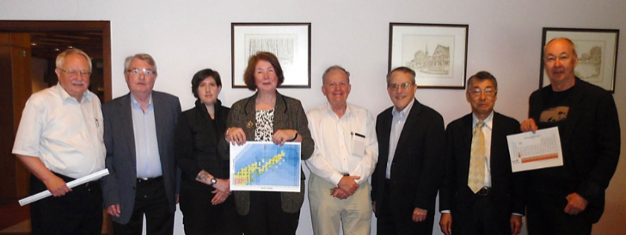

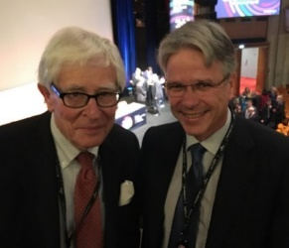


IUPAC Collaborates with Other Scientific Organizations
Notes:
International collaboration among the best scientists is how we will solve our most urgent problems from hunger to climate change. IUPAC is a key player in building a better and brighter future for all humankind through science. Through our collaboration with other organizations, IUPAC is helping to safeguard how chemistry is used, for example through our long-standing cooperation with the Organization for the Prohibition of Chemical Weapons (OPCW), UNESCO, and through our programs to promote safety in the workplace. And in the last decade, IUPAC worked closely with the BIPM (International Bureau of Weights and Measures) towards the revisions of the international system of units, changing the world's definition of the kilogram, and the mole.

Slide 6
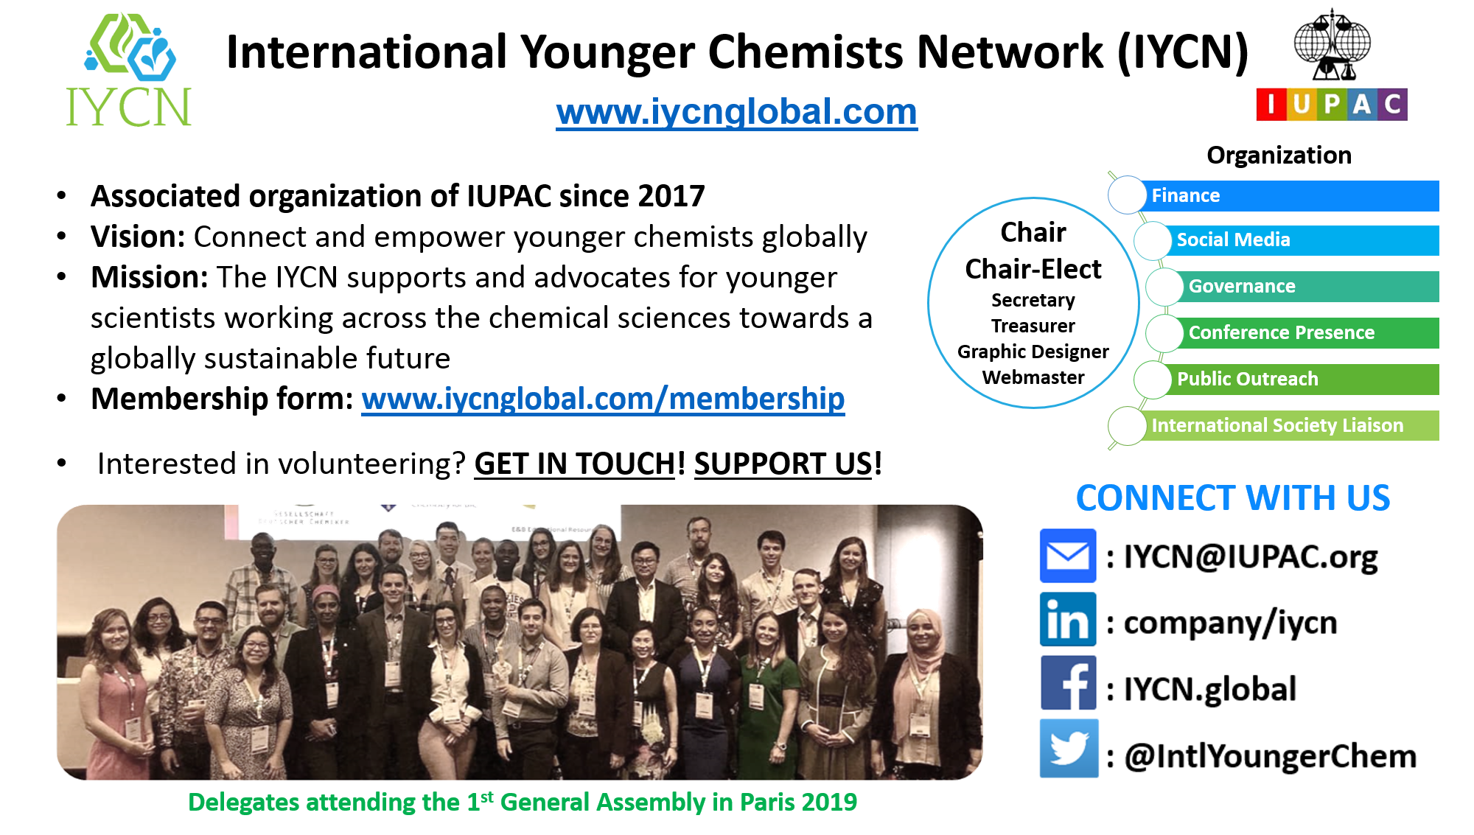
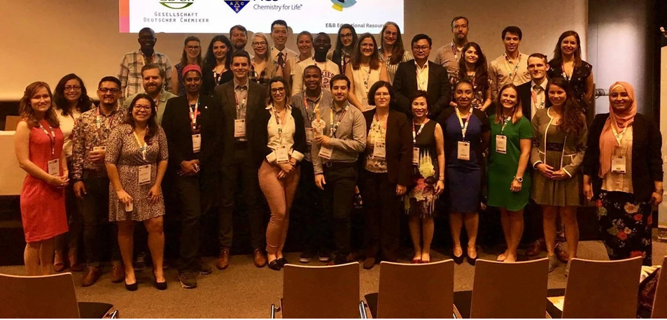
IUPAC partners with IYCN
Membership is free!
Notes:
The International Younger Chemists Network is an organization that supports and advocates for younger scientists working across the chemical sciences towards a globally sustainable future. Their vision is to connect and empower younger chemists globally. IYCN is an IUPAC associated organization. Check out their website to find out how to get involved -- they are currently accepting submissions for the 2020 IYCN Experiment Competition!

Slide 7
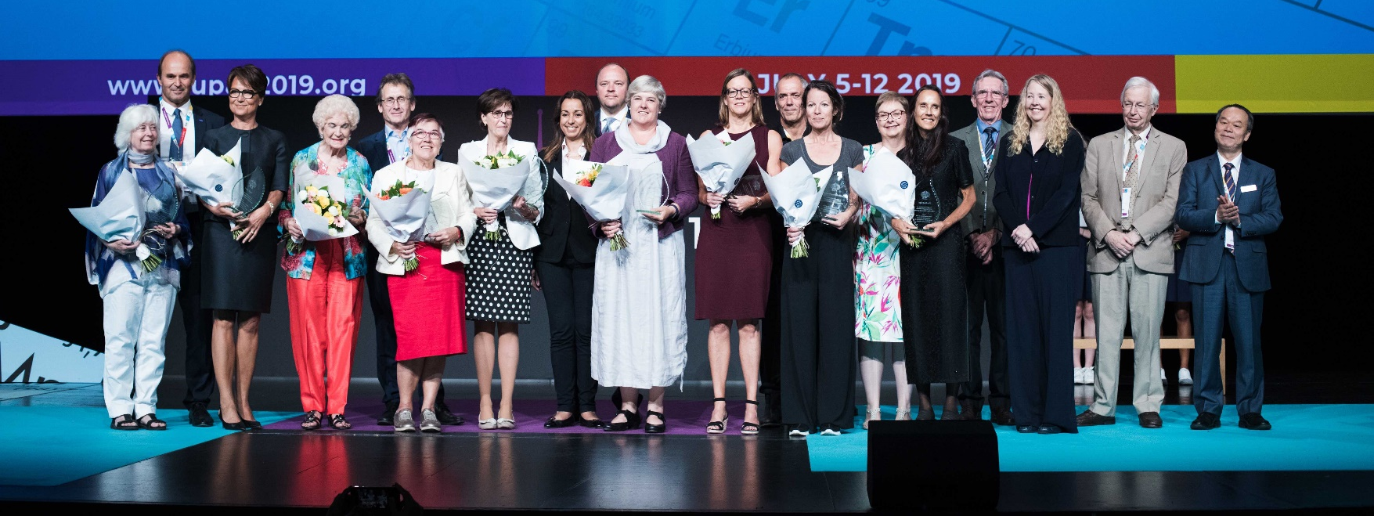
IUPAC honors Distinguished Women in Chemistry and Engineering
Notes:
The Distinguished Women in Chemistry or Chemical Engineering awards program, initiated as part of the 2011 International Year of Chemistry celebrations, was created to acknowledge and promote the work of women chemists/chemical engineers worldwide. These 12 awardees are selected each biennium based on excellence in basic or applied research, distinguished accomplishments in teaching or education, or demonstrated leadership or managerial excellence in the chemical sciences. The Awards Committee has been particularly interested in nominees with a history of leadership and/or community service during their careers.

Slide 8
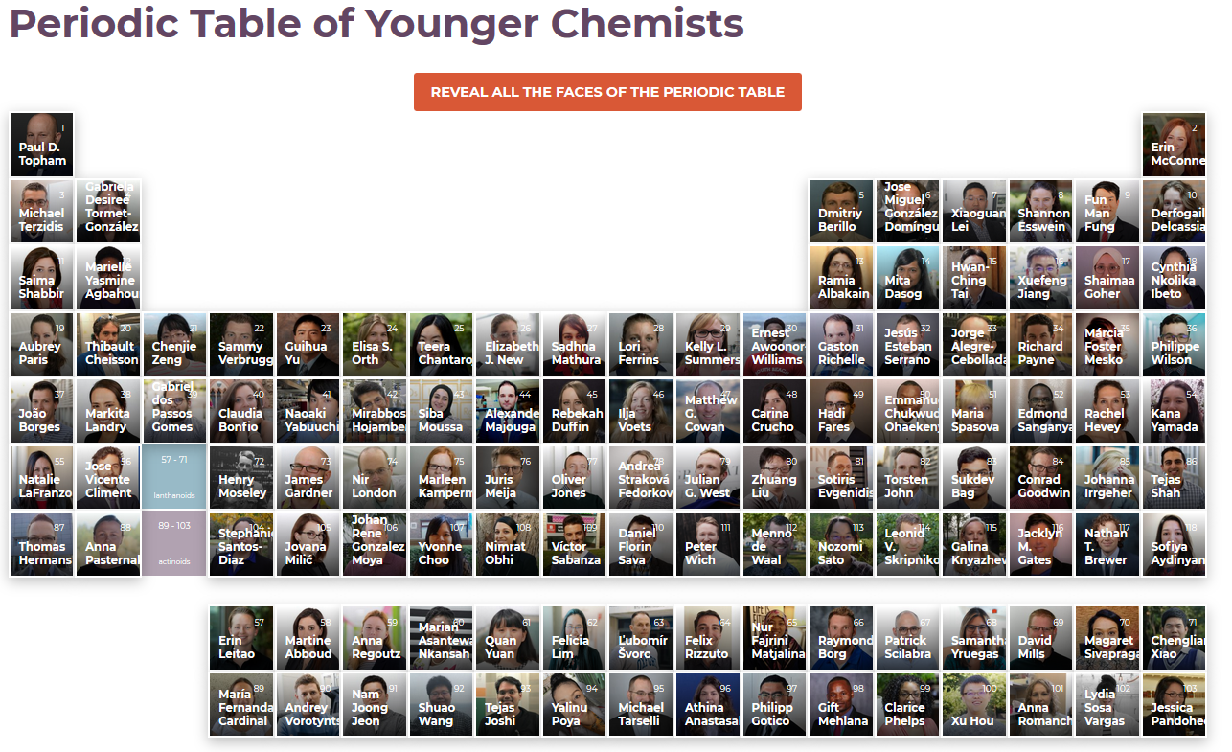
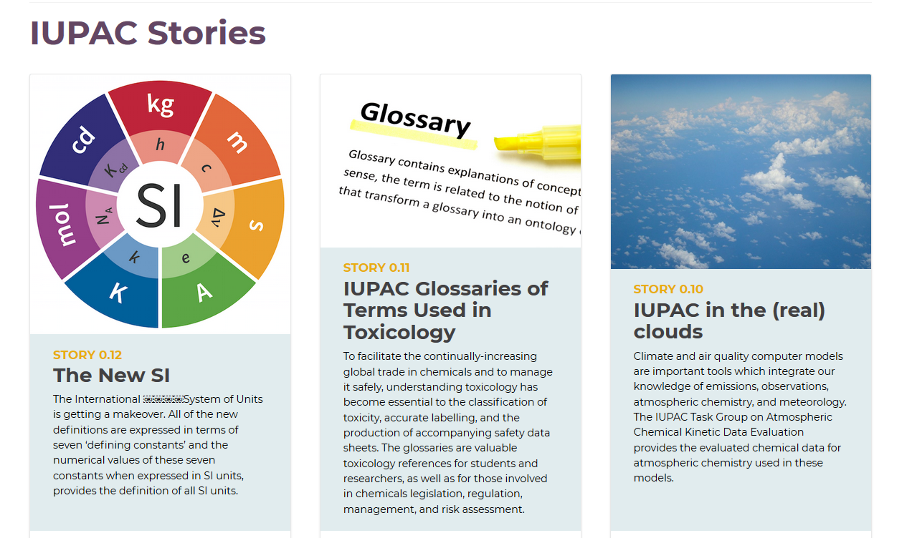
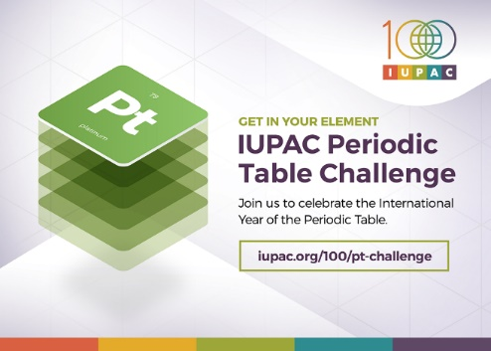
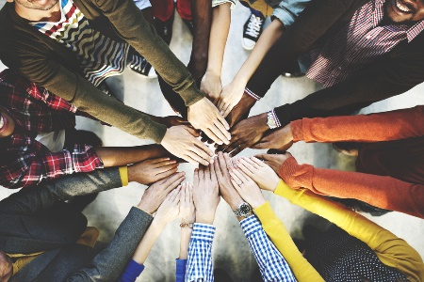
In 2019 IUPAC celebrated
100 years of “Creating a Common Language for Chemistry”
2019
Global Women’s
Breakfast
Iupac.org/100
Notes:
In 2019, the 100th anniversary of the founding of IUPAC, the Union celebrated with a number of activities including the Periodic Table of Younger Chemists, IUPAC Stories, The Periodic Table Challenge, and the Global Women’s Breakfast. In July, scientists from around the world came to Paris for the World Chemistry Congress and the IUPAC100 celebration.

Slide 9
How can you get involved in IUPAC?
Become an IUPAC affiliate member
Apply for the IUPAC-Solvay Prize for Young Chemists
Apply for the CHEMRAWN prize
Submit your ideas for the Top Ten Emerging Technologies
Consider joining an IUPAC project or becoming involved in Divisional activities
Notes:
Become an IUPAC Affiliate Member (https://iupac.org/home/registration-options/)
Apply for the IUPAC-Solvay Prize for Young Chemists by February 15 (https://iupac.org/2020-iupac-solvay-international-award-for-young-chemists/)
Apply for the CHEMRAWN prize for Green Chemistry (https://iupac.org/2020-chemrawn-vii-prize-for-green-chemistry-call-for-nominations/)
Submit your ideas for the Top Ten Emerging Technologies (https://iupac.org/what-we-do/top-ten/)
Check out all the IUPAC Awards at https://iupac.org/category/awards/

Slide 10
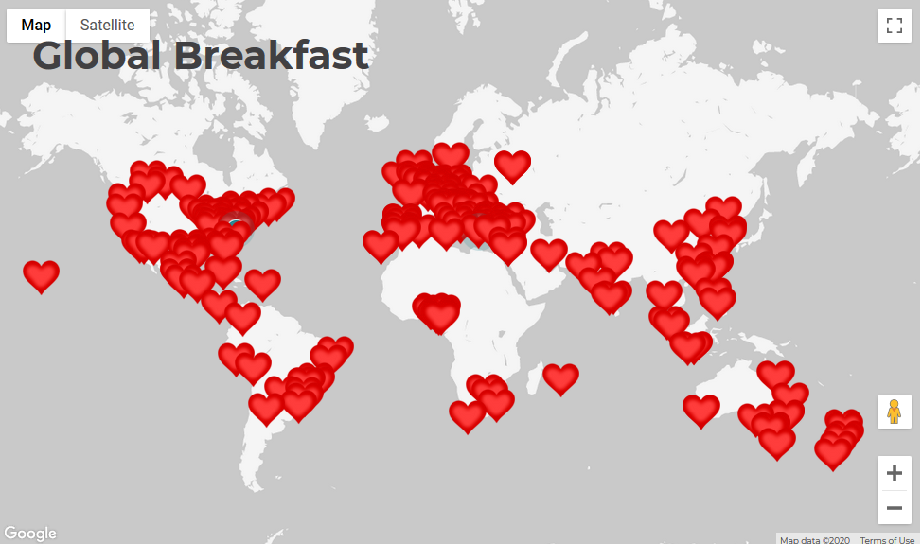


Last year the IUPAC Global Women’s Breakfast included >200 events in 50 countries
Notes:
The Global Women’s Breakfast in February was a highlight of IUPAC100. There was so much excitement when the first breakfast events began in New Zealand and we saw the map pins change, and a wave of red hearts moved around the globe. Groups of students from high school to college and professionals from industry, scientific publishing, and government all participated. Women enjoyed sharing their experiences with their colleagues and being part of a global community. Some groups had thoughtful conversations on the challenges that women face in their careers as scientists like work-life balance and the barriers that exists in some workplaces. Groups also explored how supporting young women in STEM can lead to better creativity and productivity in the chemical enterprise. The celebration clearly revealed the value of a global network of women chemists.

Slide 11
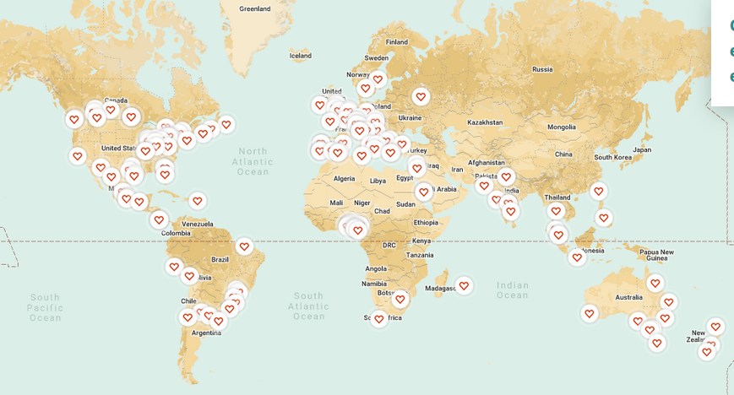
Today we are focused on “building bonds to create future leaders”

Slide 12
Call to Action Today:
Strengthen your bond with someone at your location
Reach out to another group and make a new connection
Share your knowledge and experiences & help to build new leaders
Keep building connections all year

Slide 13
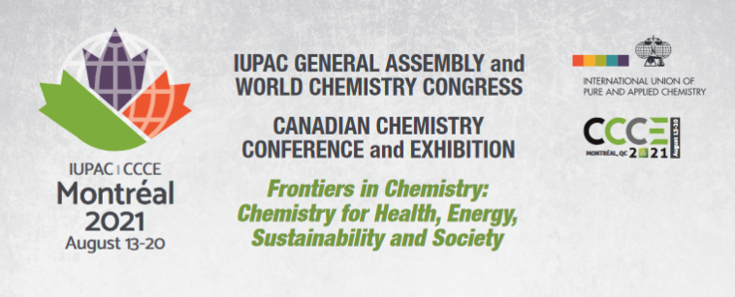
Plan now to join us in Montreal at the World Chemistry Congress
Notes:
IUPAC hosts a World Chemistry Congress every two years. The next event will be held in Montreal Canada on August 13-20, 2021. Start planning now to present your science and connect with some of the women participating today when you come to Montreal.

Slide 14
Resources for Organizers and Attendees
Webinar with Mary Garson and Frances Separovic
Welcome Video from IUPAC
Good Morning Video from Wiley
Please Share on Social Media with #GWB2020
Attendees and organizers please add your photos (especially one good group photo) and videos to the Flickr IUPAC Global Women's Breakfast Group
Notes:
Watch the Global Breakfast Webinar on Leadership with Mary Garson and Frances Separovic (https://youtu.be/YOtaSl-vDFE)
Welcome Video from IUPAC (See the GWB Information Page for the link)
Good Morning Video from Wiley (https://iupac365-my.sharepoint.com/:v:/g/personal/globalbreakfast_iupac_org/EZsD8cJnnBxJiQhd8rKYIJ0Bbx4Lu8JOcIKIasVOl2mDvg?e=K0TJFq)
Attendees and organizers please add your photos (https://www.flickr.com/groups/iupacgwb/) especially one good group photo, and videos to the Flickr IUPAC Global Women's Breakfast Group. Instructions for uploading photos and videos to Flickr is available in the "Promotional Materials" section of the GWB website.
Follow us on
Twitter @iupac https://twitter.com/IUPAC
Facebook - https://www.facebook.com/IUPAC.org
Instagram – https://www.instagram.com/iupac.global.womens.breakfast/
LinkedIn - https://www.linkedin.com/company/iupac
Flickr - https://www.flickr.com/groups/globalbreakfast/

