Slide 1

We Serve Humankind by Advancing Chemistry Worldwide
Notes:
The International Union of Pure and Applied Chemistry (IUPAC) is the globally recognized union of chemistry organizations. It is often described as the United Nations of Chemistry. The Union is made up of Nations or National Adhering Organizations. It is also made up of other associated organizations, company associates, and yes, individual affiliate members.

Slide 2



Vision
An indispensable worldwide resource for chemistry
Mission
Provides objective scientific expertise and develops the essential tools for the application and communication of chemical knowledge for the benefit of humankind and the world.
Values
Scientific excellence, communication, transparency, diversity, and ethical behavior
We Serve Humankind by Advancing Chemistry Worldwide
Notes:
The VISION of IUPAC is to be the indispensable worldwide resource for chemistry. The MISSION is to provide objective scientific expertise and to develop the essential tools for the application for chemical knowledge for the benefit of humankind and the world. Our VALUES center on scientific excellence, communication, transparency, diversity and ethical behavior.

Slide 3
IUPAC Scientific Activities
Setting and Recommending “Standards”
Publishing
Honoring
Building
Worldwide
Capacity
Sharing Emerging Science
Networking
Nomenclature, Terminology and Symbols
Recommendations Technical Reports
Periodic Table of Elements
Isotopic Abundance
Guides in Metrology (JCGM)
Journals
Books
Databases
Safety Training and Education
Outreach
Awards to Honor Scientific Contributions and Expertise
Top 10 Emerging Technologies in Chemistry (published annually)
Endorsement of Organized Symposia and Conferences
We Serve Humankind by Advancing Chemistry Worldwide
Notes:
What does IUPAC do?
The International Union of Pure and Applied Chemistry (IUPAC) is the world authority on chemical nomenclature, terminology (including the naming of new elements in the periodic table), standardized methods for measurement, atomic weights and many other critically-evaluated data. It develops and maintains Recommendations that create a common language for the global chemistry community. The scientific work of IUPAC is conducted largely through a formal Project System in which proposals from chemists around the world are peer-reviewed and, if meritorious, are approved and supported. In addition, IUPAC has many other wide-ranging activities that ultimately impact both the chemical profession and the worldwide community as a whole. These include the publishing of technical reports, journals, books, databases and other information resources that facilitate the conduct of scientific research, conferences, and the provision of awards for the recognition of scientific excellence. IUPAC is also involved in joint projects with other organizations; for example the Joint Committee for Guides in Metrology (JCGM) or the Office for the Prohibition of Chemical Weapons (OPCW). In recent years, IUPAC has become active is setting up networks of chemists with common interests (eg. chemical education in developing countries, green chemistry and sustainability)

Slide 4
Emerging Areas of Interest
SDGs-Related
Chemistry and Society
Standards for a Digital World
Achieving UN’s Sustainable Development Goals (SDGs)
Disseminate Cheminformatics Data Standards
A Bridge for Collaboration with Engineers, Technologists, Policy Makers and Industry
We Serve Humankind by Advancing Chemistry Worldwide
Notes:
Develop and Disseminate …

Slide 5
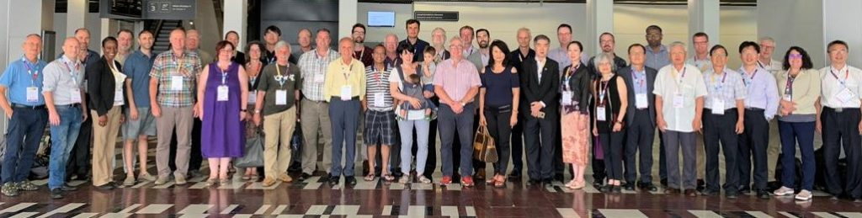
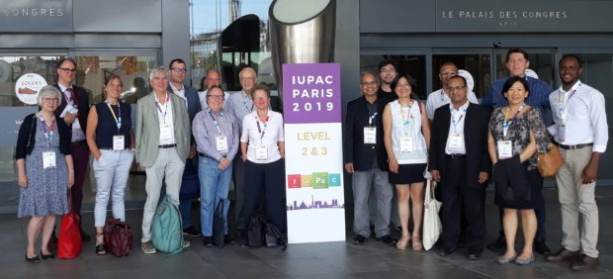
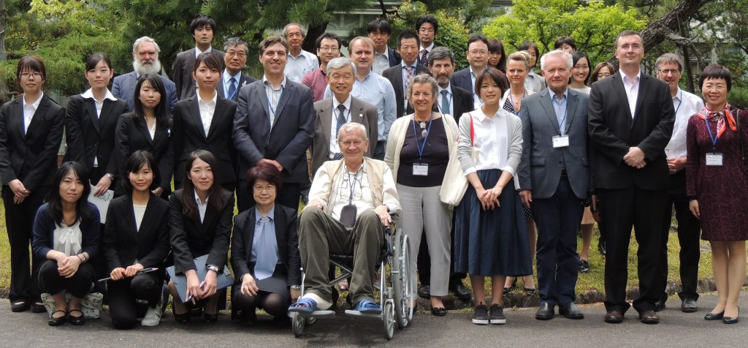
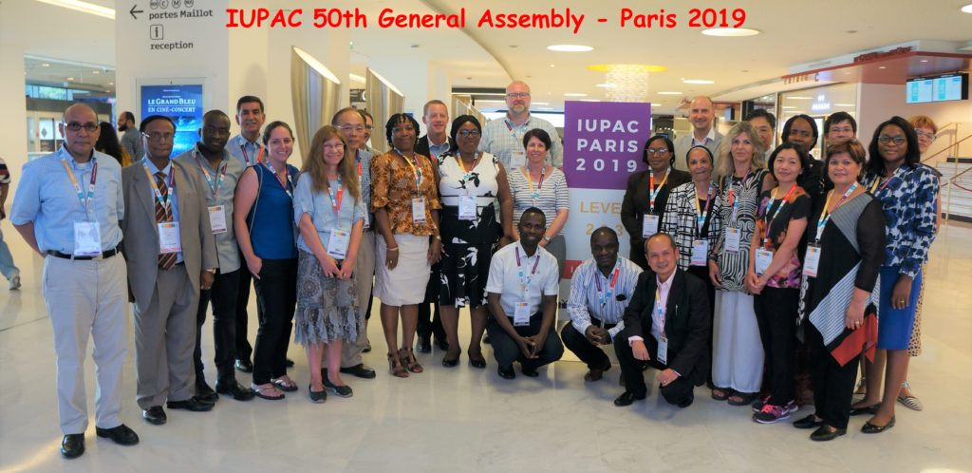
Volunteers are at the heart of IUPAC
We Serve Humankind by Advancing Chemistry Worldwide
Notes:
Volunteers work in many capacities within IUPAC: (i) as Division titular or associate members, and as national representatives). Divisional committees meet regularly (at least once a year) to discuss scientific and policy business relevant to Division; (ii) as members of Standing Committees (eg. education, green chemistry, ethics) set up by the IUPAC Council; (iii) as members of project “Task groups” set up to conduct the scientific business of IUPAC. The majority of volunteers find out about the way IUPAC works by becoming first a member of a task group, and later nominating for a Divisional or Standing Committee role.
Currently IUPAC has over 2000 volunteers working on projects or on its committees.

Slide 6
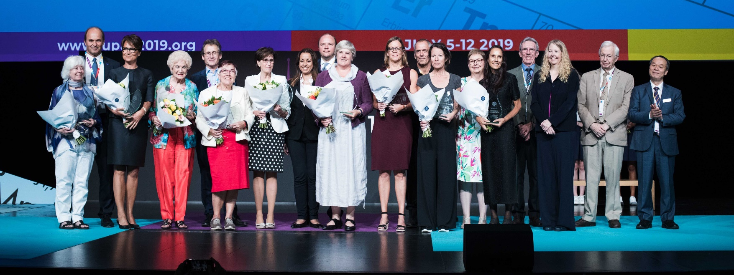
IUPAC Works to Empower Diversity in Science
Distinguished Women in Chemistry and Engineering Awards
We Serve Humankind by Advancing Chemistry Worldwide
Notes:
The Distinguished Women in Chemistry or Chemical Engineering awards program, initiated as part of the 2011 International Year of Chemistry celebrations, was created to acknowledge and promote the work of women chemists/chemical engineers worldwide. These 12 awardees are selected each biennium based on excellence in basic or applied research, distinguished accomplishments in teaching or education, or demonstrated leadership or managerial excellence in the chemical sciences. The Awards Committee has been particularly interested in nominees with a history of leadership and/or community service during their careers.

Slide 7
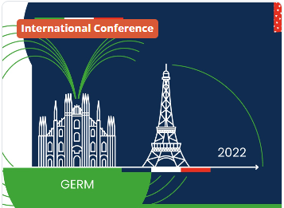
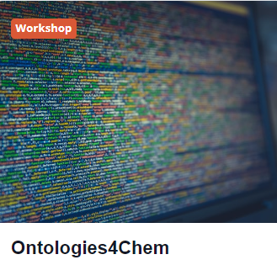
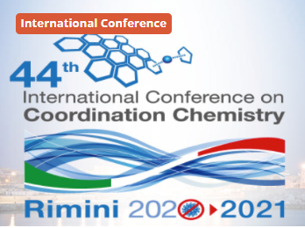
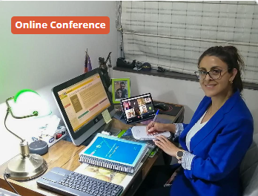

IUPAC Endorsed Conferences and Meetings
We Serve Humankind by Advancing Chemistry Worldwide

Slide 8
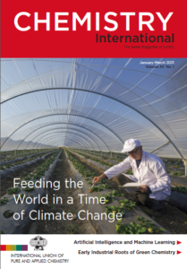
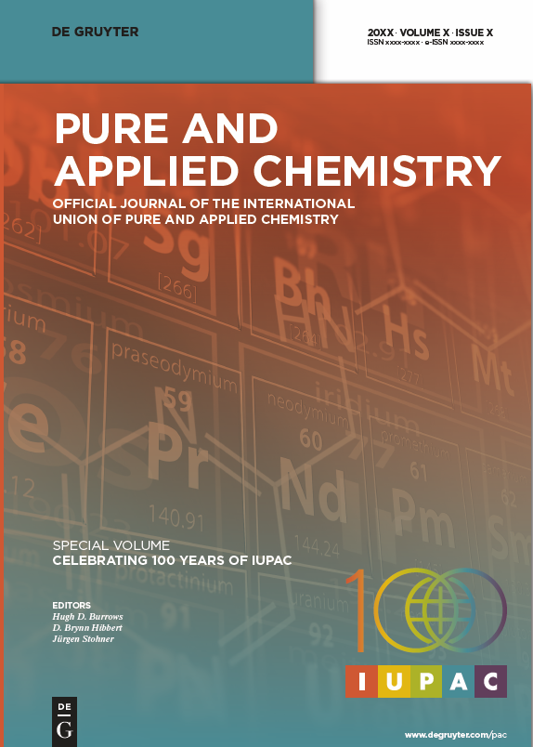
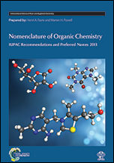
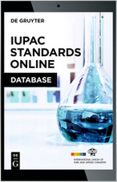
Read IUPAC Publications & Databases
iupac.org/what-we-do/books
We Serve Humankind by Advancing Chemistry Worldwide
Notes:
IUPAC disseminates the output of its scientific activities through a variety of channels, including journals that are produced in partnership with major STM publishing houses. The journals include:
Pure and Applied Chemistry (PAC) IUPAC’s official journal is published monthly and includes recommendations, technical reports, and lectures from conferences. PAC is published in partnership with De Gruyter and the online version is available on the publisher’s website. Chemistry International (CI) IUPAC’s news magazine is published bimonthly and keeps you informed of IUPAC’s activities. CI is published in partnership with De Gruyter and the online version is available on the publisher’s website. An initiative in recognition of IUPAC’s Centenary in 2019 and which end goal is to showcase the value of Chemistry (and chemists!) and to inform the general public as to how the chemical sciences contribute to the well-being of Society and the sustainability of Planet Earth is to publish each year the Top 10 Emerging Technologies in Chemistry.
Chemistry Teacher International (CTI) Peer-reviewed Open Access journal from the Committee on Chemistry Education (CCE), CTI aims to be a platform for teachers of all levels, focusing on researchers in chemistry education. It is published in partnership with De Gruyter and the online version is available on the publisher’s website The 1st issue of CTI was published in July 2019.
UPAC is the universally-recognized authority on chemical nomenclature and terminology. IUPAC develops recommendations to establish unambiguous, uniform, and consistent nomenclature and terminology for specific scientific fields, usually presented as: glossaries of terms for specific chemical disciplines; definitions of terms relating to a group of properties; nomenclature of chemical compounds and their classes; terminology, symbols, and units in a specific field; classifications and uses of terms in a specific field; and conventions and standards of practice for presenting data in a specific field. The Recommendations are published in Pure App.Chem. and also appear in the IUPAC Standards Online one year after publication in PAC. Information on chemical terminology can also be accessed through the IUPAC Color Books.IUPAC Technical Reports are scientific publications resulting from IUPAC projects or other research activities related to: the compilation and critical evaluations of data, or of parameters and equations; the critical assessment of methods and techniques; guidelines for the presentation of methods of analysis or for the calibration of instruments; determinations of specific elements or compounds in selected samples in special environments; studies of the biodegradability of materials; chemical process control aspects; and evaluations of properties of specific materials. The manuscripts are reviewed by the IUPAC International Committee on Terminology, Nomenclature and Symbols for consistency of nomenclature and symbols usage with current IUPAC standards.

Slide 9
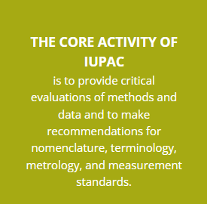
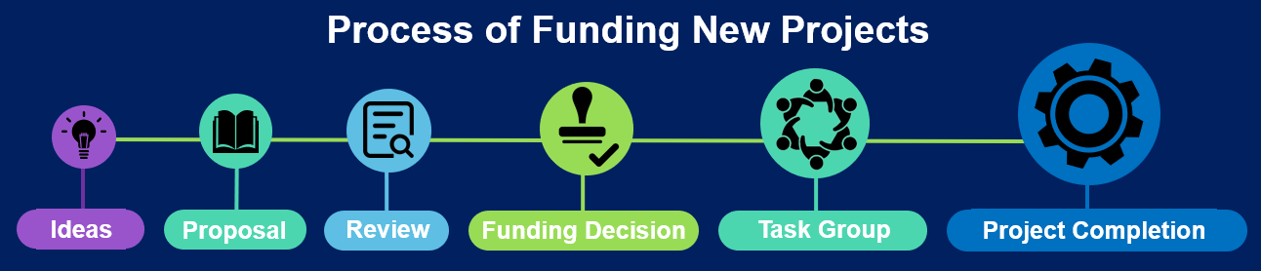
IUPAC Project System Supports the Core Activities of IUPAC
We Serve Humankind by Advancing Chemistry Worldwide
Notes:
Need to put some notes here to explain

Slide 10
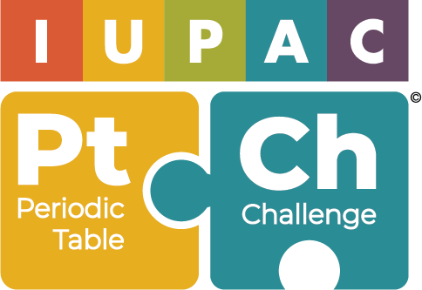
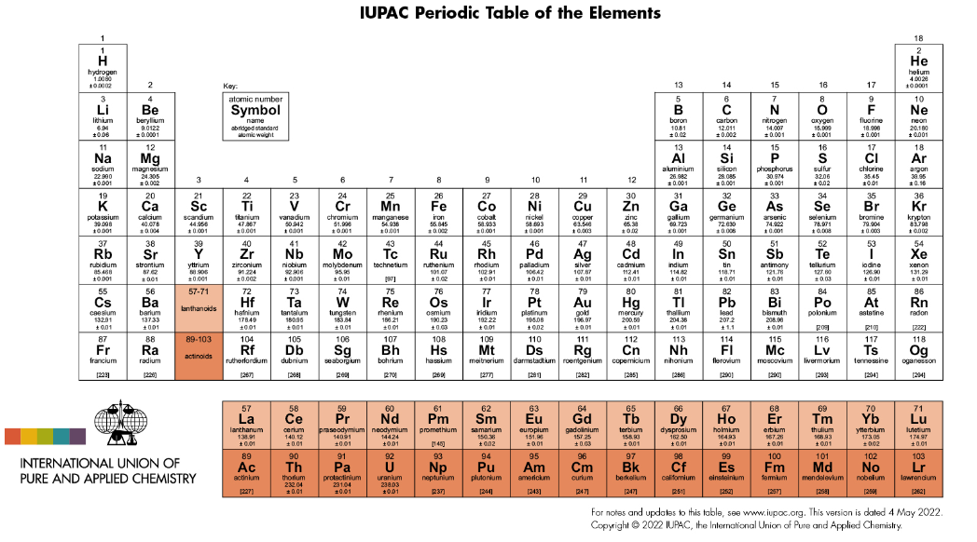
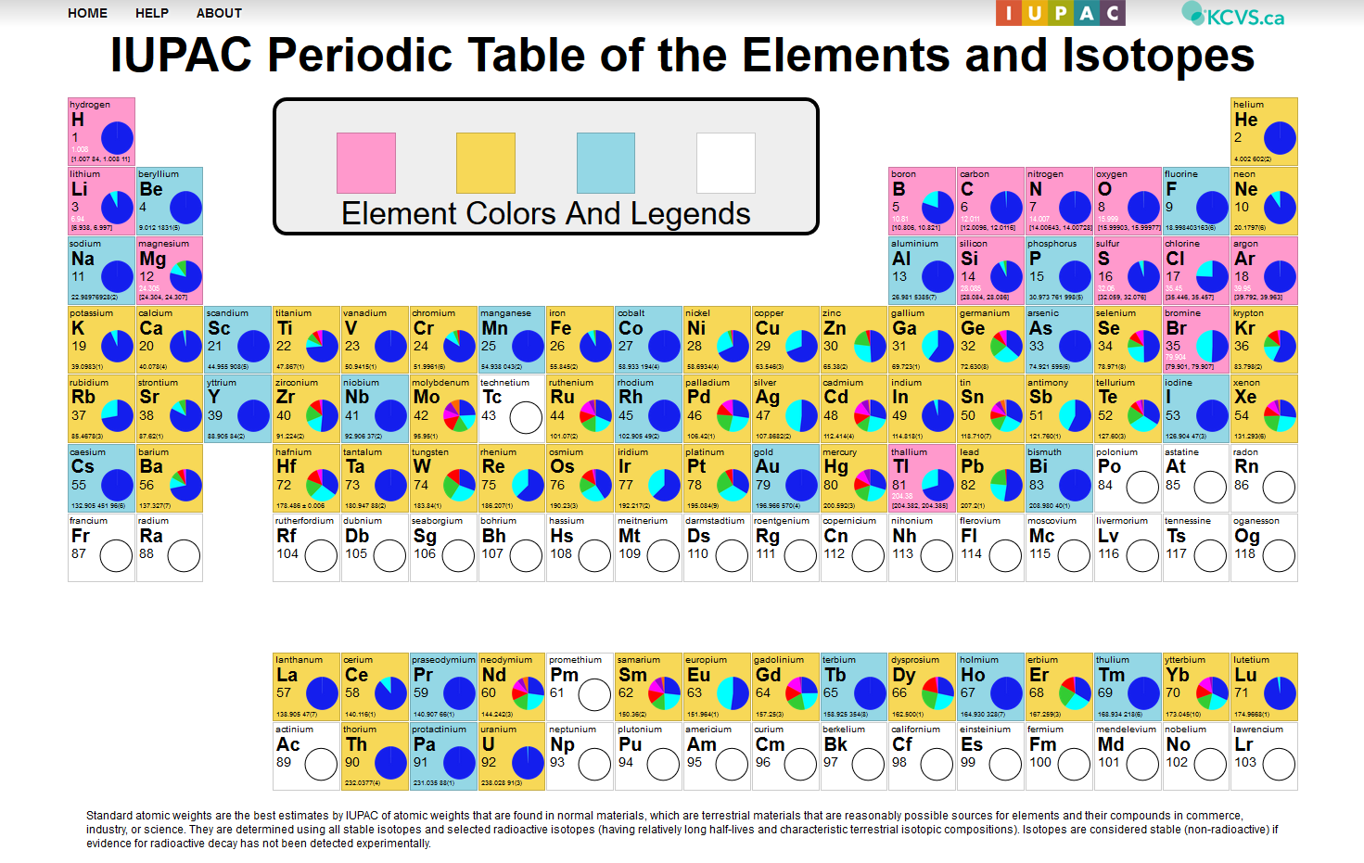
Use the IUPAC Educational Tools!
iupac.org/what-we-do/periodic-table-of-elements
iupac.org/periodic-table-challenge
applets.kcvs.ca/IPTEI/IPTEI.html
We Serve Humankind by Advancing Chemistry Worldwide
Notes:
IUPAC plays a major role in dissemination information about the Periodic Table and updates on it to the global community; The latest release of the Periodic Table (1 Dec 2018) includes the most recent updates released in June 2018 by the IUPAC Commission on Isotopic Abundances and Atomic Weights.
The Periodic Table Challenge is a fun activity aimed at younger chemists and designed to test their knowledge of the Periodic Table; the competition runs in English, Spanish, Arabic, Chinese, Russian and (soon) Italian; a higher level competition is available to those who score highly in the entry level competition.

Slide 11
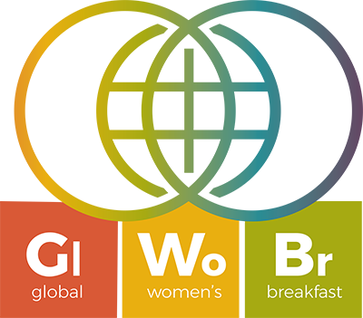
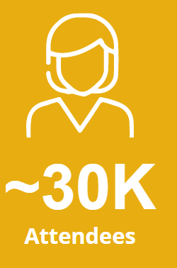
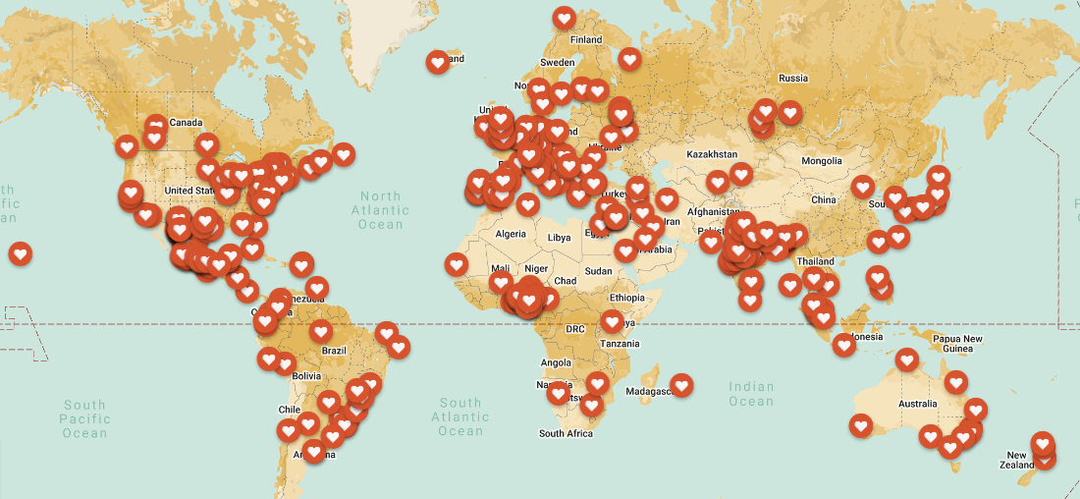

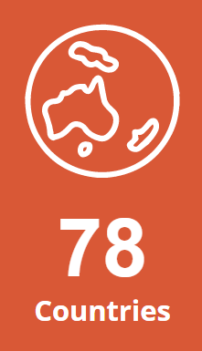
Join the 2023 Global Women’s Breakfast
14 February 2023
“Breaking Barriers in Science”
https://iupac.org/gwb/highlights-from-gwb2022/
We Serve Humankind by Advancing Chemistry Worldwide
Notes:
2011 – in celebration of the International Year of Chemistry; held in >40 countries
2019 – in celebration of the centenary of IUPAC/International Year of the Periodic Table; held in >50 countries; theme Empowering Women in Chemistry
2020 - >200 different events held in >50 countries; theme Building Bonds to Create Better Leaders
2021- theme Empowering Diversity in Science;
Reports such as the recent Breaking the Barriers report of RSC (UK) describe many “road blocks” to career progression. Although these issues affect both men and women, the UK data show that women are disproportionally affected. Thus strategies for encouraging creative and motivated young people of both genders to continue with chemistry are required, but also to ensure that many more women are represented in senior ranks. An important reason for continuing to host GWB during the pandemic is to connect together young men and women chemists, many of whom will be feeling lonely or isolated during lockdown or work-from-home arrangements. With so many now familiar with video platforms such as Zoom, MS teams, Google Teams, connecting chemists regionally has never been easier!
A project team has been set up to connect GWB breakfast organisers, and to coordinate efforts to reduce the gender gap around the globe.

Slide 12
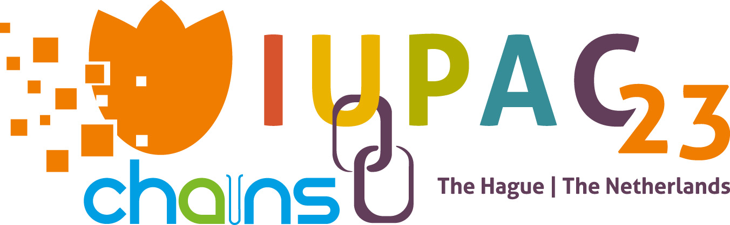
Plan now to join us at the 49th IUPAC World Chemistry Congress
18-25 August 2023
https://iupac2023.org
We Serve Humankind by Advancing Chemistry Worldwide
Notes:
Every 2 years, an NAO of IUPAC hosts a World Chemistry Congress together with the General Assembly and Council meetings of IUPAC. The scientific meeting showcases the very best and most current chemistry from leading chemistry specialists, together with specialist symposia (chemical education, green chemistry, history of chemistry etc). The General Assembly and Council meetings are the main business meetings in which all sectors of IUPAC come together to review progress and to plan the next activities. New NAO members are accepted at the Council meeting, and elections are held for senior leadership positions within IUPAC.

Slide 13
Thank You!
We Serve Humankind by Advancing Chemistry Worldwide
Notes:
Thank you for your attention!

Slide 14
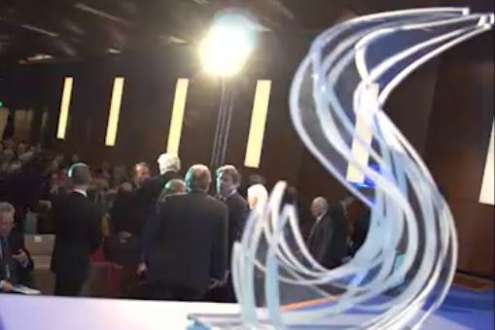
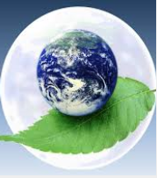

A Few of Many IUPAC Awards Programs
iupac.org/what-we-do/awards
IUPAC-ThalesNano Prize in Flow Chemistry and Microfluidics
IUPAC-Zhejiang NHU International Award for Advancements in Green Chemistry
IUPAC-Solvay International Award for Young Chemists
We Serve Humankind by Advancing Chemistry Worldwide
Notes:
IUPAC offers a number of awards to honor scientific contributions and expertise. The slide shows three awards that have imminent closing dates, but a full list of all IUPACs prizes and awards is available from the website:
IUPAC-SOLVAY International Award for Young Chemists Established in 2000 to encourage outstanding young research scientists at the beginning of their careers. The awards are given for the most outstanding Ph.D. theses in the general area of the chemical sciences, as described in a 1000-word essay.
IUPAC-ThalesNano Prize in Flow Chemistry Established to honor an internationally recognized scientist, whose activities or published accounts have made an outstanding contribution in the field of flow chemistry in academia or industry.
IUPAC-Zhejiang NHU International Award for Advancements in Green Chemistry Established to encourage young and experienced chemists, and to emphasize the importance of advancements in Green Chemistry and the value of sciences to human progress. The award covers all the topics of Green Chemistry, such as Green and Renewable Feedstocks, Green Synthetic Routes, Green Solvents, Green Catalysis, Green products, Green Energy, and as broadly defined by OECD as Sustainable Chemistry.

Slide 15
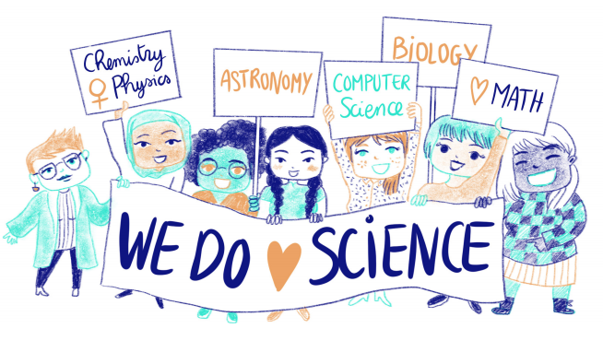
IUPAC Works to Empower Diversity in Science
Partner in ISC “Gender Gap in Science” Project
https://gender-gap-in-science.org/
We Serve Humankind by Advancing Chemistry Worldwide
Notes:
Mathematical and natural sciences have long and honorable traditions of participation by highly creative women contributors. However, the percentages of women scientists remain shockingly low and there is a significant gender gap at all levels between women and men. Barriers to achievement by women persist, especially in developing countries.
The project “A Global Approach to the Gender Gap in Mathematical, Computing, and Natural Sciences: How to Measure It, How to Reduce It?” has produced sound data to support the choices of interventions that ICSU and member unions can feasibly undertake.
Currently, existing data on participation of women in the mathematical and natural sciences is scattered, outdated, and inconsistent across regions and research fields. The project provided evidence to support the making of informed decisions on science policy. Temporal trends were included, as the situation of women in science is constantly evolving, sometimes with some negative developments. Data was collected via both a joint global survey and a bibliographic study of publication patterns. The survey reached 45,000 respondents in more than 130 countries using at least 10 languages, while the study of publication patterns analyzed comprehensive metadata sources corresponding to publications of more than 500,000 scientists since 1970. Contrasts and common ground across regions and cultures, less developed and highly developed countries, men and women, mathematical and natural sciences, were highlighted.

Slide 16
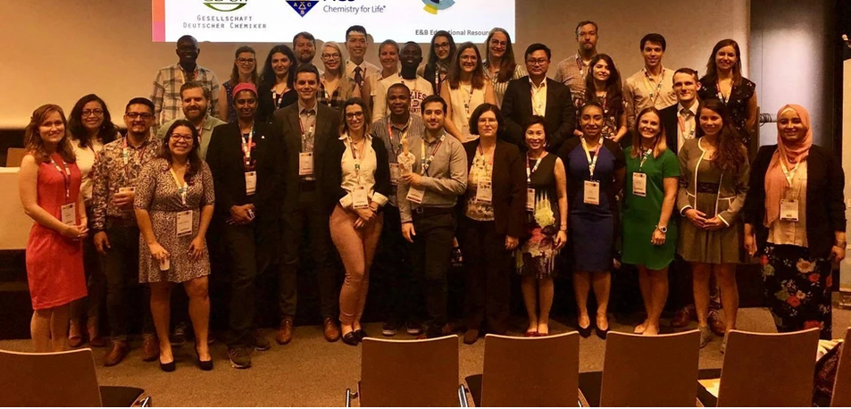
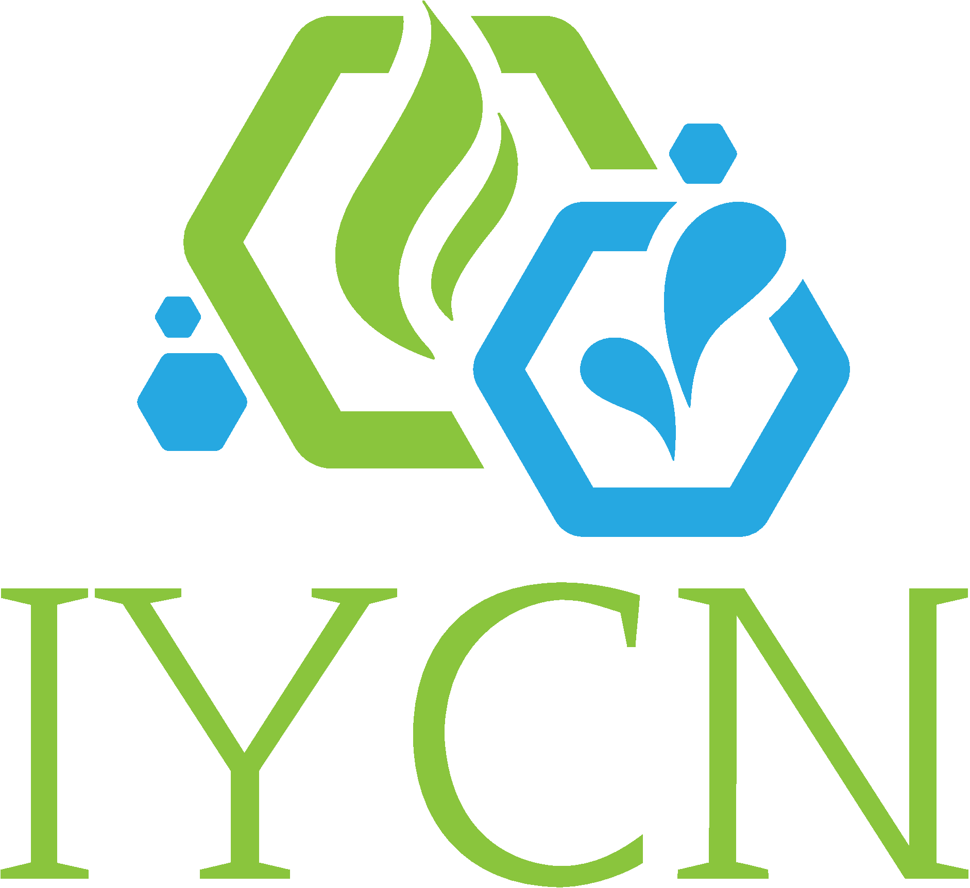
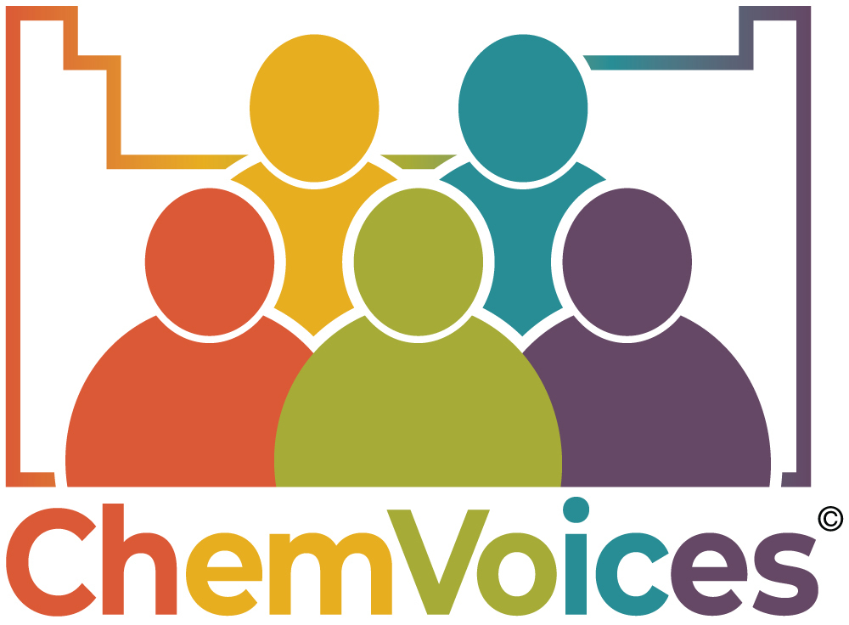
IUPAC Works to Empower Diversity in Science
We partner with International Younger Chemists Network
www.iycnglobal.com
https://chemvoices.org/
We Serve Humankind by Advancing Chemistry Worldwide
Notes:
IYCN has been set up to better connect and empower young chemists globally. Its mission is to support and advocate for younger scientists working across the chemical sciences towards a globally sustainable future. In most developing countries national chemical societies do not have key programs for the sustainable integration of students and early career professionals. IYCN aims to develop into a network of early career chemists and establish a lasting system to foster growth and mentorship in chemistry. In partnership with IUPAC, IYCN has set up ChemVoices, a website created to showcase the talents and impact of early-career scientists worldwide. IYCN also runs a Sustainable Goals Development website.

