Slide 1

100 Years of Creating a Common Language for Chemistry

Slide 2
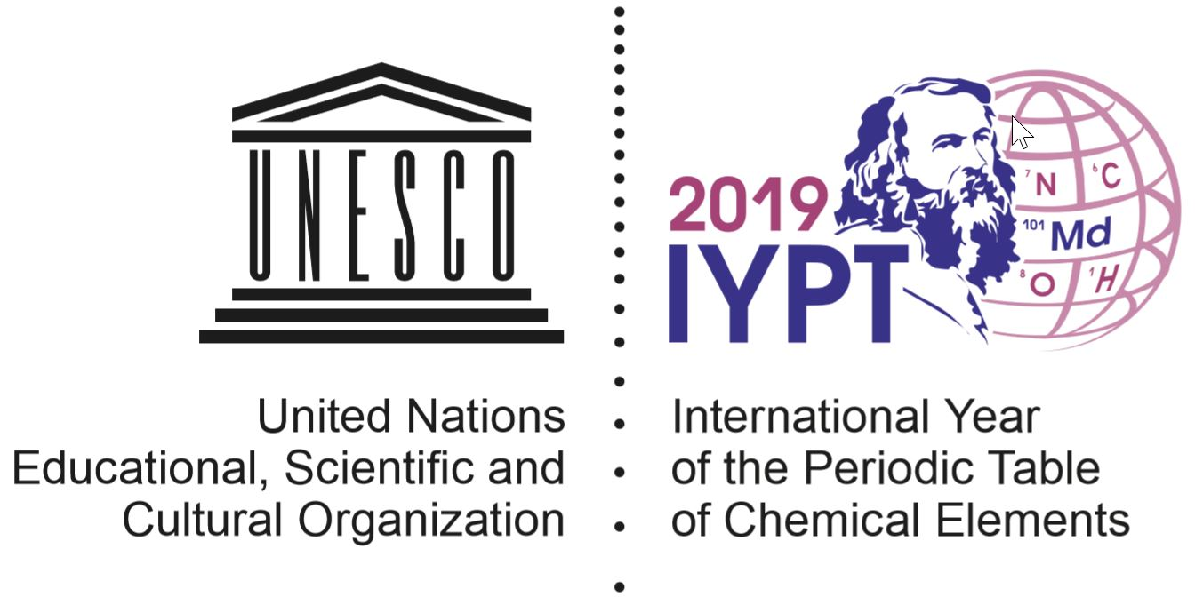
Two Global Celebrations in 2019
100 YEARS of CREATING A COMMON LANGUAGE FOR CHEMISTRY

Slide 3
IUPAC100
2019 is the 100th Anniversary of the founding of IUPAC
Year long celebration highlighting the contributions of IUPAC and looking forward to the next century
Interactive website platform at to encourage participation in global activities and to organize local events
Use the hashtag #iupac100 on Twitter (@IUPAC) and Instagram
Co-chairs: Prof. Mary Garson & Dr. Laura McConnell
Email: iupac100@iupac.org
Website: www.iupac.org/100
100 YEARS of CREATING A COMMON LANGUAGE FOR CHEMISTRY

Slide 4
IUPAC100 Global Activities www.iupac.org/100
Activity | Target Audience | Description | Timing
Periodic Table Challenge | High School & General Public | On-line competition for Periodic Table Challenge | Throughout 2019
Empowering Women in Chemistry: A Global Breakfast Event | Women scientists and students | On-line global networking event celebrating the achievements of women chemists | February 12, 2019
Periodic Table of Younger Chemists | Undergraduate and early career scientists | 118 outstanding young scientists recognized by awarding “elements” | Monthly announcements from July 2018 to July 2019
IUPAC Stories | Chemistry community and General Public | Monthly stories of essential tools developed by IUPAC | April 2018 to December 2019
Postgraduate Summer School on Green Chemistry in Africa (Tanzania) | Early career chemists in Africa | Increase knowledge in the field of Green Chemistry in Africa, contributing to sustainable development | May 2019

Slide 5
International Year of the Periodic Table
IUPAC in partnership with UNESCO and 5 other Organizations
Celebrating 150th Anniversary of the Periodic Table
www.iypt2019.org
Co-chairs: Prof. Natalia Tarasova & Prof. Jan Reedijk
Email: iypt2019@iupac.org
Partner Organizations: International Union of Pure and Applied Physics (IUPAP) European Association for Chemical and Molecular Sciences (EuCheMS) The International Council for Science (ICSU) International Astronomical Union (IAU) The International Union of History and Philosophy of Science and Technology (IUHPS)

Slide 6
IYPT Events & Activities www.iypt2019.org
Activity | Description | Timing
Opening Ceremony | Celebration at UNESCO in Paris | January 29, 2019
Periodic Table Challenge | Joint activity with IUPAC100 | Throughout 2019
Opening Ceremony in Russia | Birthday of Mendeleev | February 7, 2019
Symposium in Murcia, Spain | Plans in development | May, 2019
5th EuCheMS Inorganic Chemistry Conference | Conference in Moscow | June, 2019
Special Symposium: The Periodic Table at 150 | Part of Paris 2019 IUPAC World Chemistry Congress | July, 2019
Periodic Tables for Young Students in Africa | Distribute Periodic Tables to young students in Africa | 2019
Closing Ceremony | Location to be determined | December 2019

Slide 7
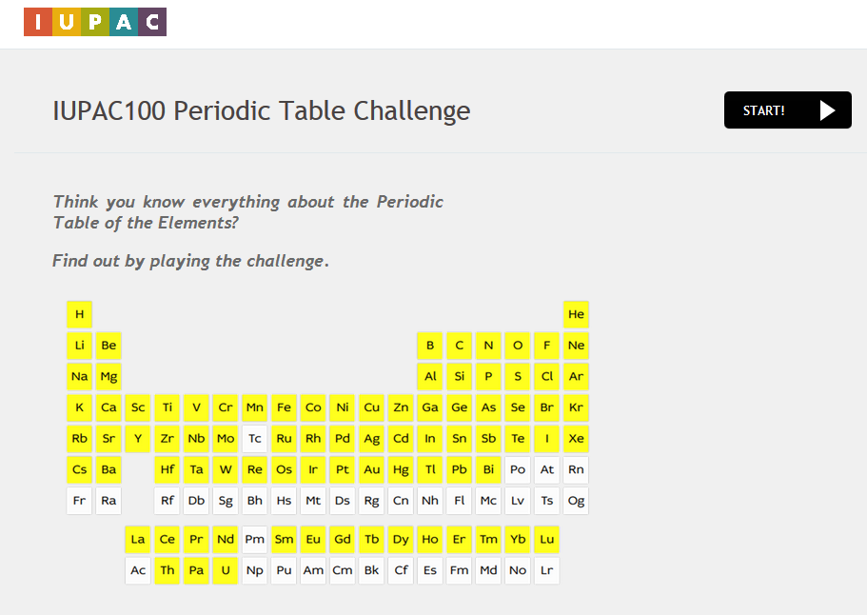
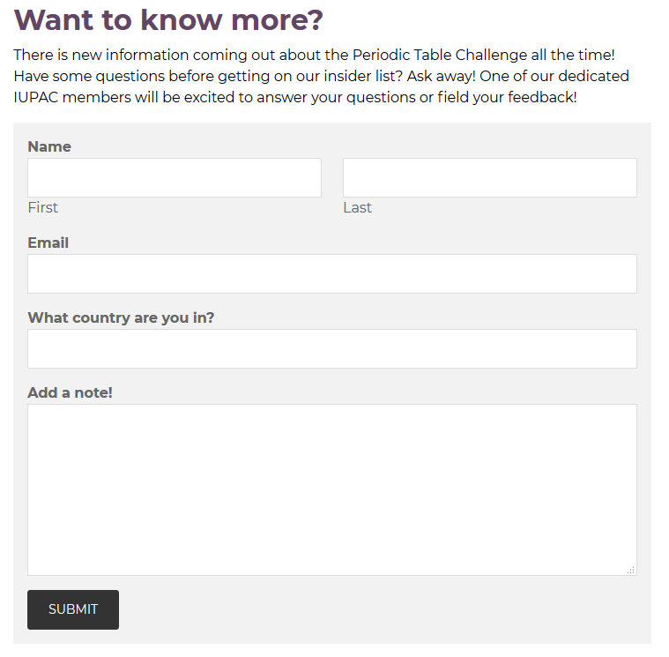
Periodic Table Challenge
IUPAC will host an online quiz about the Periodic Table of the Elements.
It will highlight how IUPAC has shaped the global affairs of chemistry and contributed to creating a common language for chemistry.
The online challenge will be aimed at a global audience of young students.
Questions about the elements will quiz their knowledge and inform them of the relevant work of IUPAC.
The global challenge will be launched in January 2019 and is available all year until the end of 2019.
Information and to receive updates is available: https://iupac.org/100/pt-challenge/

Slide 8
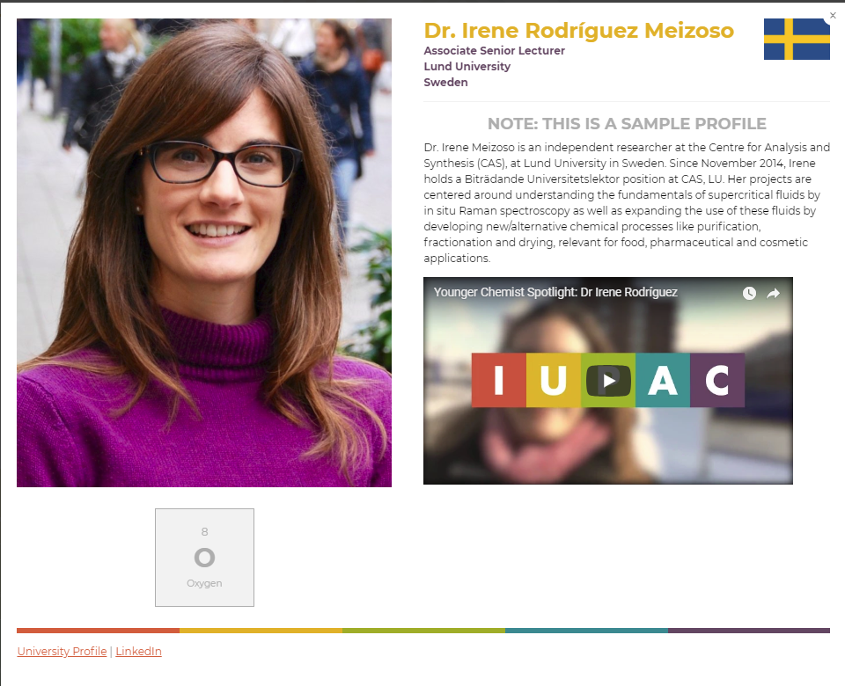
Periodic Table of Younger Chemists in partnership with International Younger Chemist Network (IYCN)
Will honor a diverse group of 118 outstanding younger chemists from around the world who in embody the mission and core values of IUPAC.
Periodic table will highlight the diversity of careers, creativity, and dedication of young chemists leading us into the next century.
Winners will be profiled on the IUPAC100 website and will receive a certificate from the IUPAC.
Elements of the Periodic Table of Younger Chemists will be revealed over time in order of scientific discovery from July 2018 to July 2019.
Nomination Submission is open! https://iupac.org/100/pt-of-chemist/
Watch the videos to learn more!
https://www.youtube.com/channel/UCKg5DzBtxwnB45S3PRcX_qw?view_as=subscriber

Slide 9
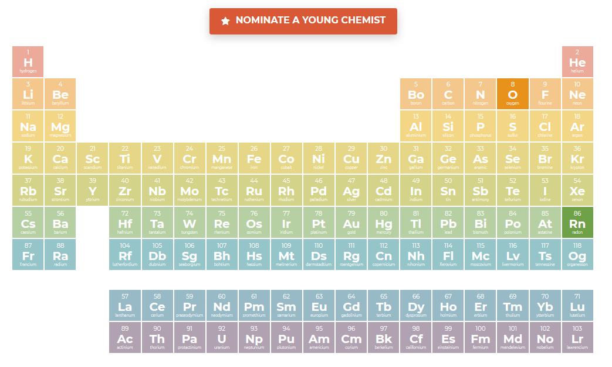
Periodic Table of Younger Chemists
Criteria for nomination:
Nominees should be 40 years of age or younger and meet the following criteria:
One of the following:
Currently pursuing an undergraduate or graduate degree in chemistry or a related field
Holds an undergraduate or graduate degree in chemistry or in a related field
Is currently working in the field of chemistry or a related field
AND
Actively working in one or more of the following areas:
Scientific topics relevant to the United Nations Sustainable Development Goals
Increasing the public appreciation and understanding of chemistry
Fostering diversity in the chemical enterprise
Improving chemistry and science education for students
Advancing interdisciplinary and international collaboration in chemistry research

Slide 10
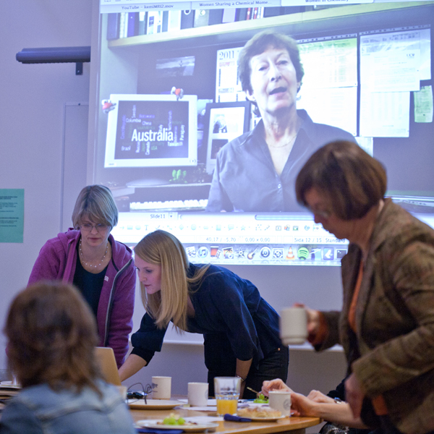
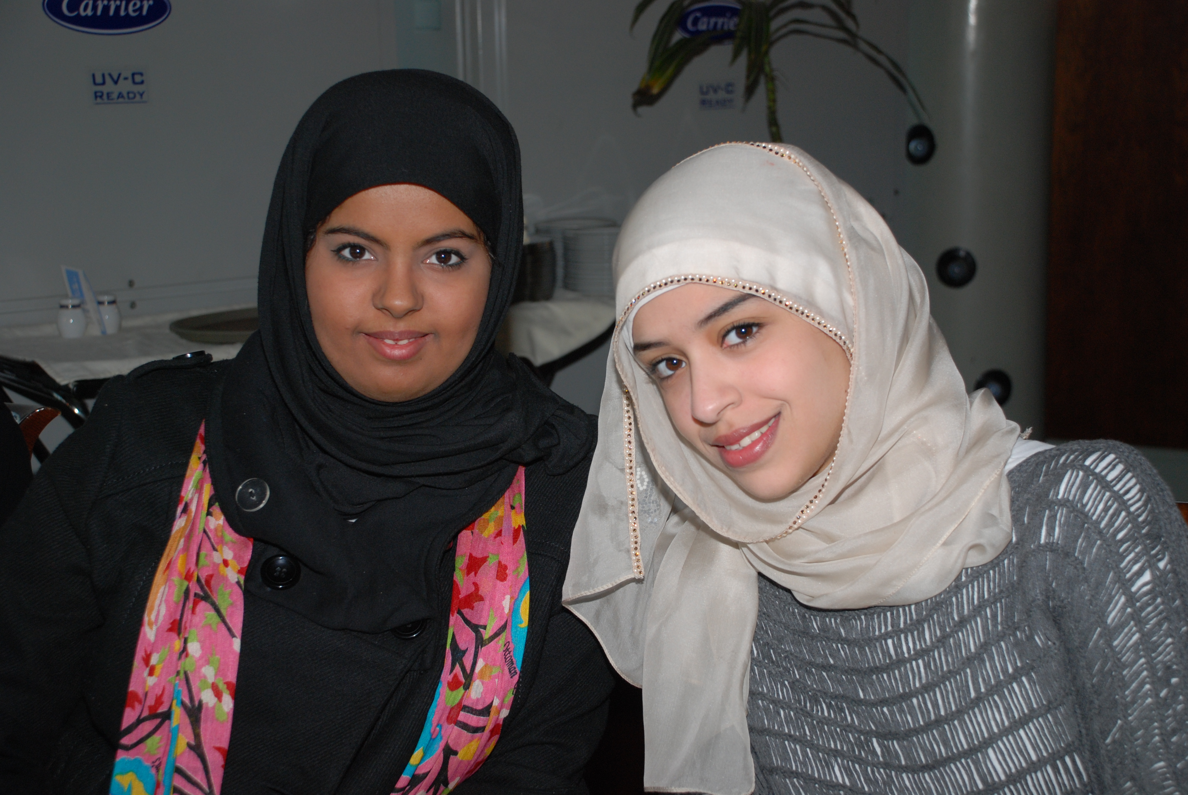
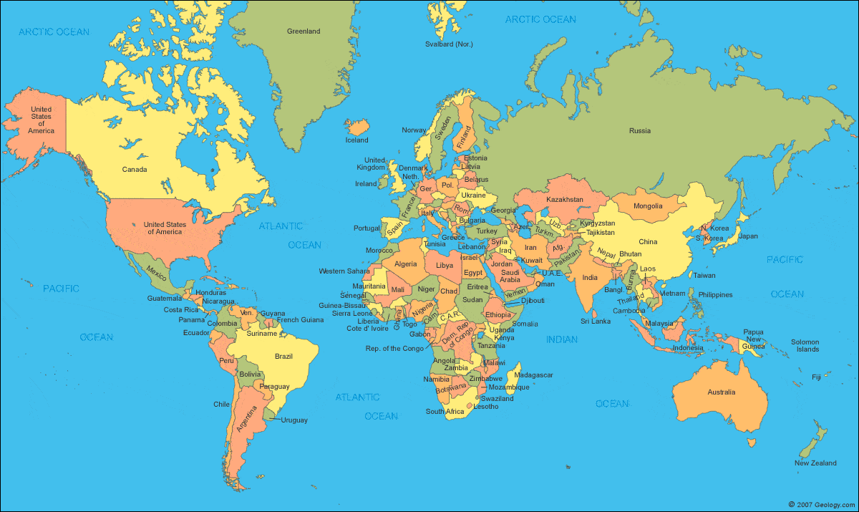
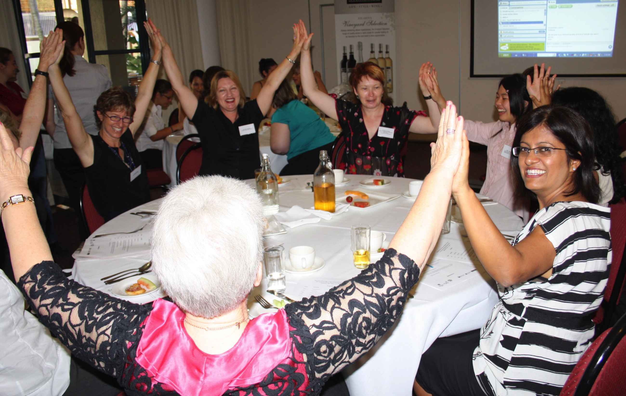
Empowering Women in Chemistry: A Global Breakfast Event
When: Tuesday 12 February 2019
Highlights:
Hear about inspirational women chemists
Discussion on career progression
Opportunity to network with other women
Roundtable discussions
Find out about existing networks in your region
AND
Interactive skype session with other breakfasts
Social media feed (Twitter, Instagram)
Hashtag #iupac100
Sweden
Kuwait
Paraguay
Brisbane

Slide 11


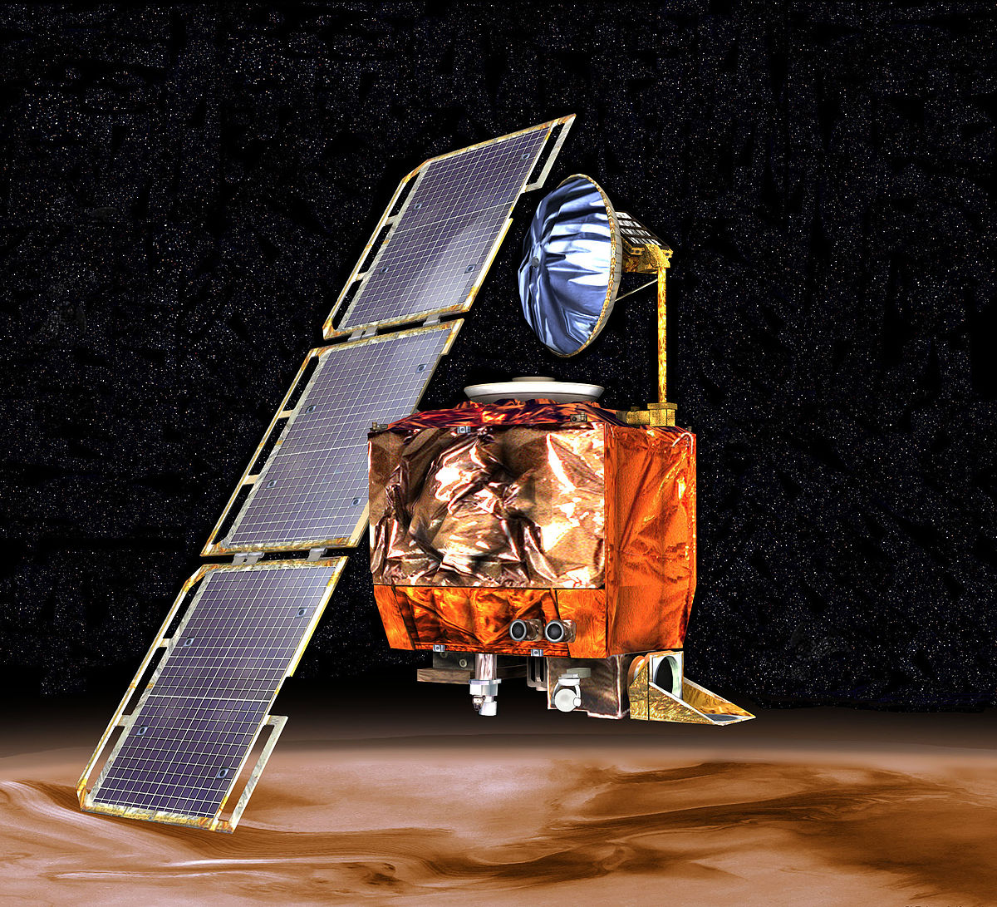
IUPAC Stories
What on Earth is InChI?
Monthly stories to highlight IUPAC’s mission and accomplishments.
Demonstrate how we provide objective scientific expertise and develop the essential tools for the application and communication of chemical knowledge for the benefit of humankind and the world.
Illustrate how they are being used by scientists on an everyday basis, and examine how they are relevant to the future of chemistry.
The Wikipedia Polymer Partnership
Why does the World need a Common Language for Scientists?
Mars Climate Orbiter
Notes:
Excerpts from the three stories as reference (not intended to be prescriptive to the speaker)
The IUPAC Chemical Identifier or InChI (“pronounced “en-chee”) is a world-wide computer based standard for chemical structure representation created by the collaboration of chemists around the world under the auspices of IUPAC. The InChI format and algorithm are non-proprietary and the software is open source, with ongoing development done by the chemistry community. The result of this world-wide collaborative effort has been the development, maintenance, and expansion of the capabilities of the open source, freely available, nonproprietary International Chemical Identifier (InChI), first by NIST and now by the InChI Trust (1), a not‑for‑profit UK charity which is supported by contributions from member organizations.
the idea came up in the IUPAC Division IV (Polymer Division), to somehow combine Wikipedia entries related to polymer chemistry and physics with the approved and published IUPAC definitions, so that the fast access to a term by the Wikipedia system is combined with the IUPAC approved and therefore reliable definition. In the first place this can be done when there are Wikipedia entries and corresponding IUPAC definitions. In cases where there are no Wikipedia entries, authors from IUPAC are asked to provide new Wikipedia entries.
IUPAC is the world authority on chemical nomenclature and terminology, including the naming of new elements in the periodic table; on standardized methods for measurement; on relative atomic masses (“atomic weights”), and many other critically-evaluated data within the broad spectrum that embraces the chemical sciences.
IUPAC is also involved in the revision of the new SI (International System of Units) which has consequences for the chemical community via the redefinition of the Avogadro constant.
Why Do We Need a Common Language in Chemical Sciences?
There are several reasons for setting international standards by IUPAC that are relevant to society. These are (i) saving resources, (ii) saving money, and (iii) saving lives. Let us consider a few examples.
The American NASA Mars Climate Orbiter was lost 1999 due to an incorrect conversion between metric and English (USA) units. While, the financial loss amounted to about $125 million US dollars, a price cannot be placed on the loss of scientific data and associated work.

Slide 12
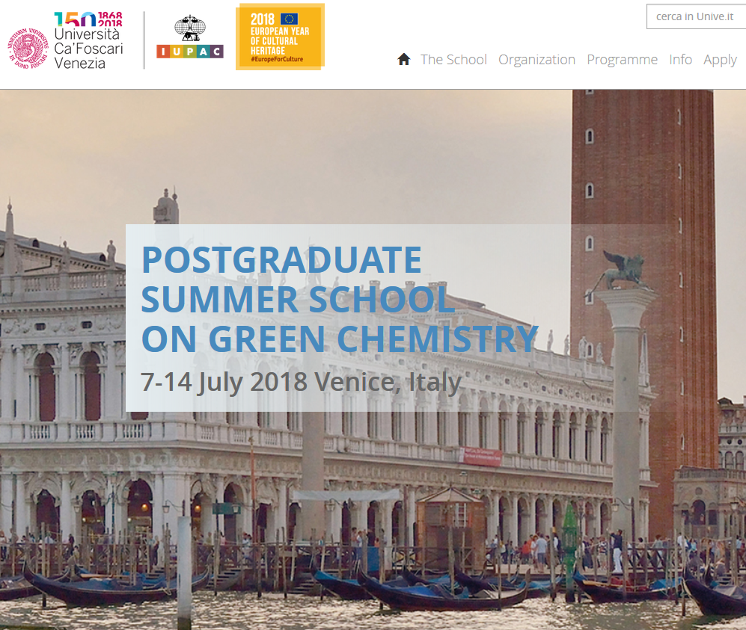
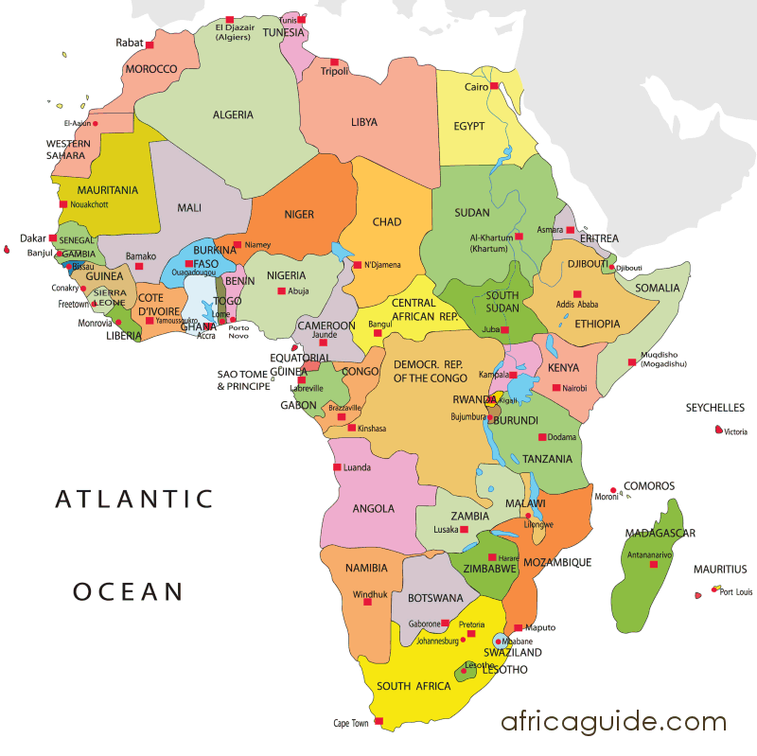
Postgraduate Summer School on Green Chemistry in Africa
Coming in 2019

Slide 13
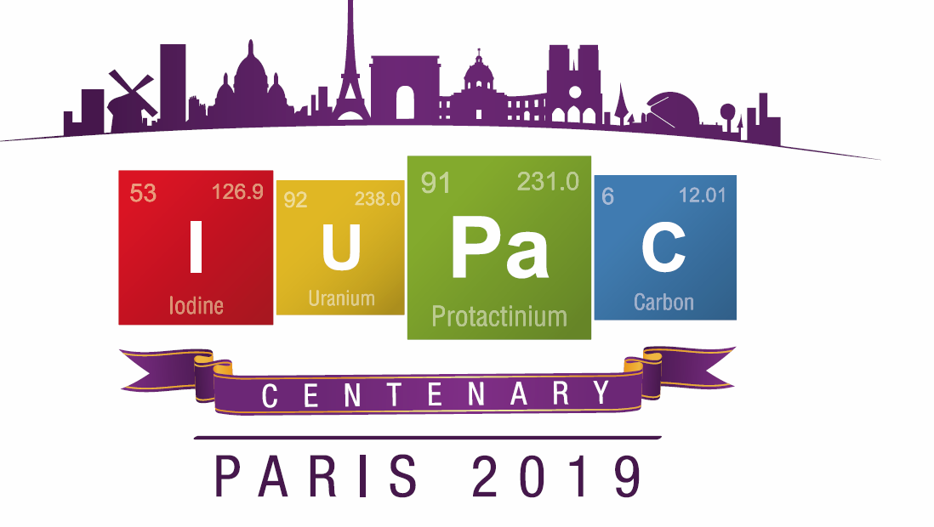
47th World Chemistry Congress 50th IUPAC General Assembly Paris, France, July 5-12, 2019 www.iupac2019.org

Slide 14
IUPAC100 and IYPT Events at PARIS 2019
Special Presentation and Celebration of 100 years of IUPAC
Announcement of final elements of Periodic Table of Younger Chemists
World Chemistry Leaders Initiative
Special Symposium: The Periodic Table at 150

