Slide 1

International Union
of
Pure and Applied CHEMISTRY
---
IUPAC Global Role and Activities
www.iupac.org

Slide 2




Vision
An indispensable worldwide resource for chemistry
Mission
Provides objective scientific expertise and develops the essential tools for the application and communication of chemical knowledge for the benefit of humankind and the world.
Values
Scientific excellence, communication, transparency, diversity, and ethical behavior
Notes:
The VISION of IUPAC is to be an indispensable worldwide resource for chemistry.
The MISSION is to provide objective scientific expertise and to develop the essential tools for the application for chemical knowledge for the benefit of humankind and the world.
The VALUES center on scientific excellence, communication, transparency, diversity and ethical behavior.
How does IUPAC uniqueness translate into roles that contribute to advancement of chemistry?

Slide 3

IUPAC’s unique role in the world chemistry community
• A focus on those aspects of chemistry where global consensus is essential for progress in research, commerce and policy.
• Respect for its objectivity and scientific excellence, providing access to the highest levels in the scientific, industrial, and policy communities to represent global chemistry.
• A worldwide base of volunteer scientists with the best skills and background, recruited by transparent and well-understood processes.
• Links with international organisations: UNESCO, OPCW, UNEP…
• UN Sustainable Development Goals
Notes:
NEXT
How does IUPAC accomplish its mission ?
Providing a common language for chemistry
Fostering sustainable development
Advocating the free exchange of scientific information

Slide 4
How does IUPAC accomplish its mission ?
Providing a common language for chemistry
Fostering sustainable development
Advocating the free exchange of scientific information
Notes:
NEXT Governance and memberships

Slide 5
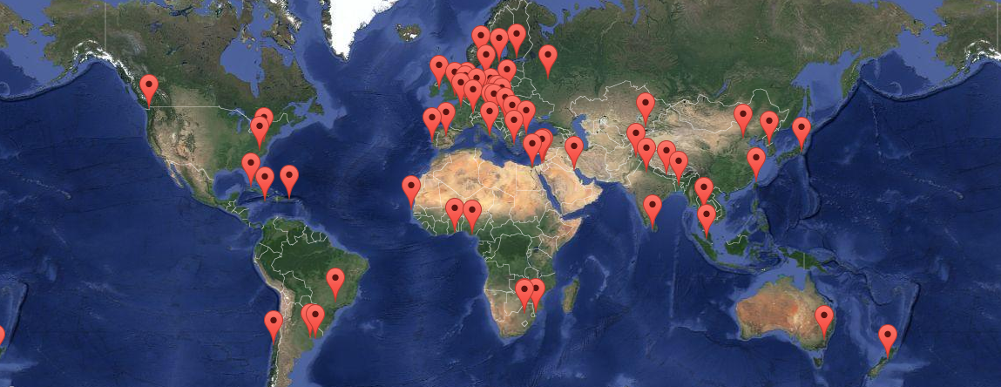
Governance by Member Nations (54)

Slide 6
IUPAC Membership
National Adhering Organizations (NAO) - the Governing bodies (Council) of IUPAC Chemical Societies, National Academies and institutions representing national chemical interests
Associate National Adhering Organizations
Observer Status
Associated Organizations (AO)
International organizations that share common goals and interest with IUPAC
Company Associates (CA)
Industrial companies, research and development institutions
Individual Members (affiliate members, AMP)
Membership for individuals (coordinated by NAOs, Societies or directly with IUPAC)
Notes:
Membership from organization to individuals

Slide 7

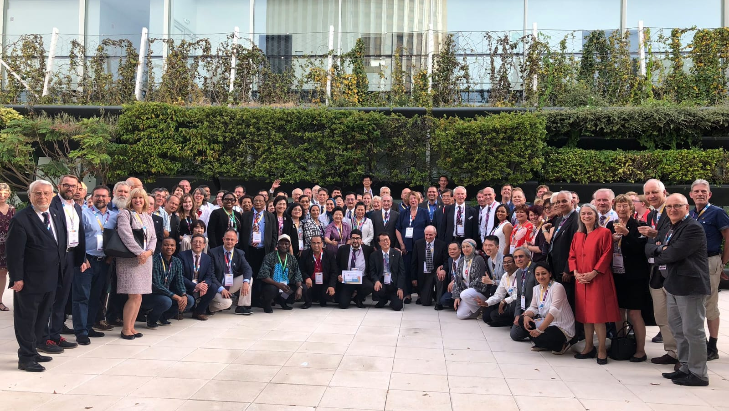
Notes:
Member Nations still means people > this is the group of representatives at the IUPAC Council in Paris in July 2019

Slide 8

Affiliate Membership
Individuals may become affiliated with IUPAC through the Affiliate Membership Program (AMP). Chemical Societies and other organizations may coordinate this program and share in the income.
> Support IUPAC Mission
> Access a global network
> Member on IUPAC Division / Committee
> Project/Task Group leader
> Discount registration on IUPAC endorsed conferences and IUPAC books
Notes:
From Individuals to Volunteers

Slide 9
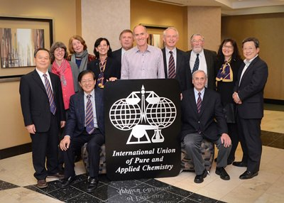
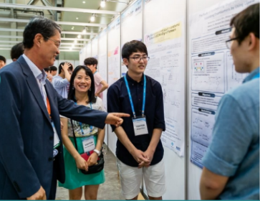
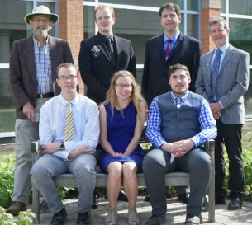
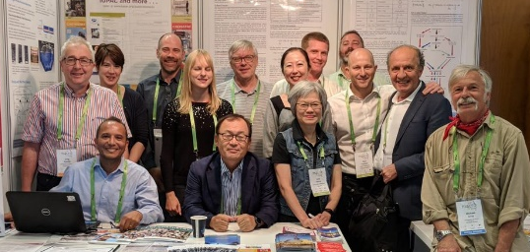
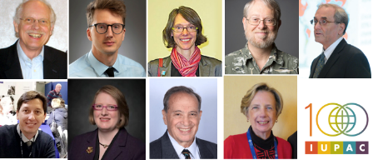
Working Groups fueled by 1000s of volunteer experts
Divisions
Physical and Biophysical
Inorganic
Organic
Polymer
Analytical
Environment
Human Health
Nomenclature & Terminology
Committees
Cheminformatics & Data Standards
Green Chemistry
Education
Industry
Research Applied for World Needs
International Younger Chemists Network (IYCN)
Notes:
… and IYCN

Slide 10
IUPAC Scientific Activities
Setting and Recommending “Standards”
Publishing
Honoring
Building
Worldwide
Capacity
Sharing Emerging Science
Networking
Journals
Books
Databases
Awards to honor Scientific Contributions and Expertise
Nomenclature, Terminology and Symbols (Recommendations & Report)
Periodic Table of Elements
Isotopic Abundance
Guides in Metrology
Safety Training
Education
Outreach
Top 10 Emerging Technologies in Chemistry
Endorsement of Symposia and Intl. Conferences
Notes:
What does IUPAC do? the world authority on chemical nomenclature, terminology (including the naming of new elements in the periodic table), standardized methods for measurement, atomic weights and many other critically-evaluated data. It develops and maintains Recommendations that create a common language for the global chemistry community. The scientific work of IUPAC is conducted largely through a formal Project System in which proposals from chemists around the world are peer-reviewed and, if meritorious, are approved and supported. In addition, IUPAC has many other wide-ranging activities that ultimately impact both the chemical profession and the worldwide community as a whole.
These include the publishing of technical reports, journals, books, databases and other information resources that facilitate the conduct of scientific research, conferences, and the provision of awards for the recognition of scientific excellence. IUPAC is also involved in joint projects with other organizations; for example the Joint Committee for Guides in Metrology (JCGM) or the Office for the Prohibition of Chemical Weapons (OPCW). In recent years, IUPAC has become active is setting up networks of chemists with common interests (eg. chemical education in developing countries, green chemistry and sustainability)

Slide 11
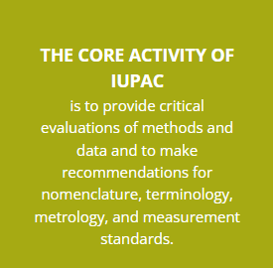
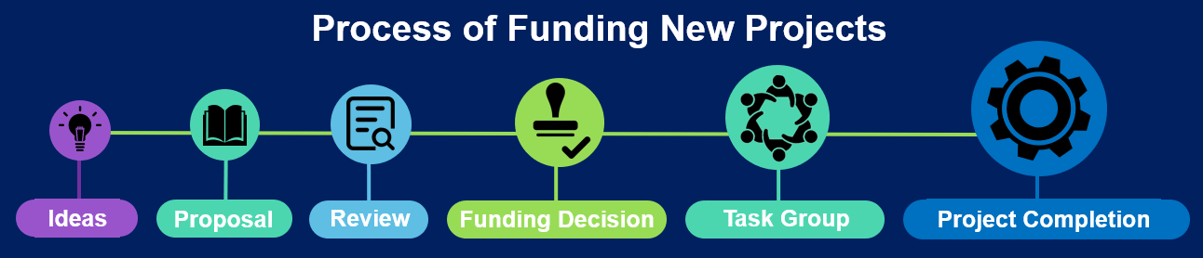
IUPAC Project System Supports the Core Activities of IUPAC
Anyone with a good idea can submit a project proposal.
IUPAC project funding is to facilitate the work of volunteers.

Slide 12
Primary Activities
Development of the Language of Chemistry
Nomenclature, Symbols, Terminology
Standardization of Chemistry Methods
Data Presentation, including Data Exchange Standards for Computers and Instruments
Study of Analytical Methods
Critical Evaluation of Physico-Chemical Data
Atomic Weights
Thermodynamic Data
Kinetic Data

Slide 13
IUPAC Scientific Activities
Setting and Recommending “Standards”
Publishing
Honoring
Building
Worldwide
Capacity
Sharing Emerging Science
Networking
Journals
Books
Databases
Awards to honor Scientific Contributions and Expertise
Nomenclature, Terminology and Symbols (Recommendations & Report)
Periodic Table of Elements
Isotopic Abundance
Guides in Metrology
Safety Training
Education
Outreach
Endorsement of Symposia and Intl. Conferences
Top 10 Emerging Technologies in Chemistry
Endorsement of Symposia and Intl. Conferences
Notes:
Sharing Emerging Science
Top 10
FAIR

Slide 14
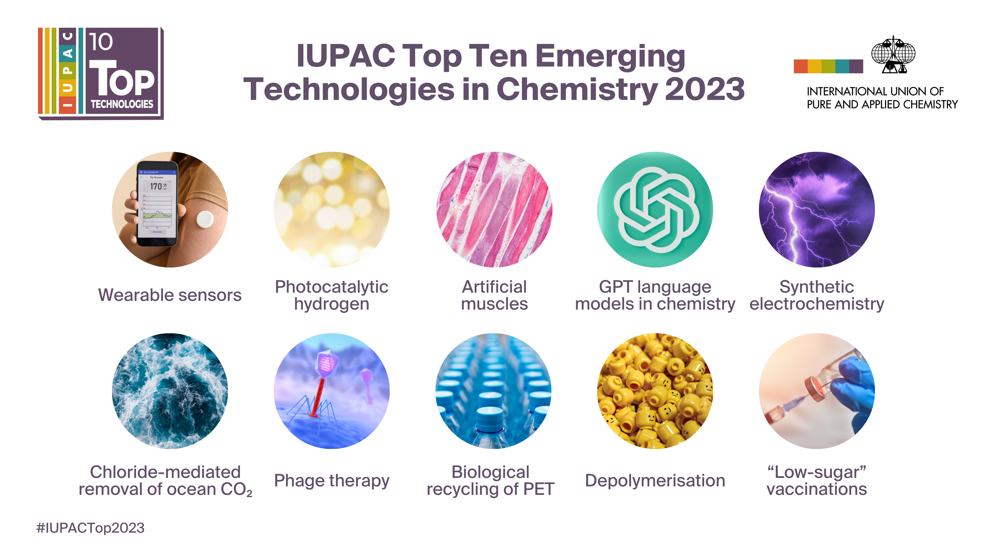

Slide 15
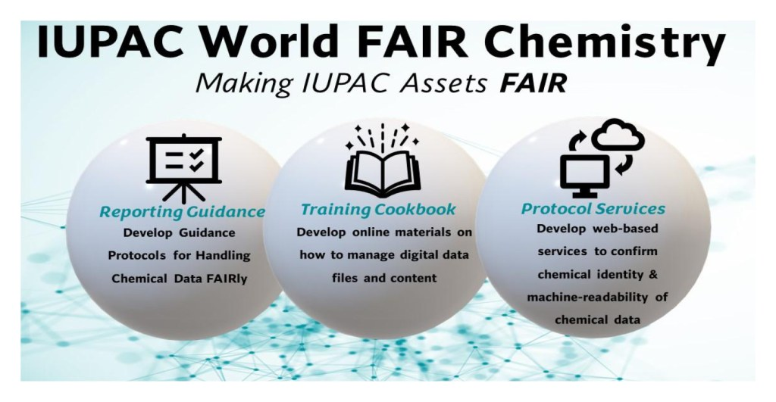
Notes:
FAIR > (Findable, Accessible, Interoperable, Reusable ) Data Principles

Slide 16
Emerging Areas of Interest
Standards for a Digital World
Chemistry and Society
SDGs-Related
Disseminate Cheminformatics Data Standards
Collaborate with Engineers, Technologists, Policy Makers and Industry
Achieve UN’s Sustainable Development Goals (SDGs)
Notes:
Sharing Emerging Science is also addressing worldwide challenge and working with other (see later under Networking)

Slide 17
IUPAC Scientific Activities
Setting and Recommending “Standards”
Publishing
Honoring
Building
Worldwide
Capacity
Sharing Emerging Science
Networking
Journals
Books
Databases
Awards to honor Scientific Contributions and Expertise
Nomenclature, Terminology and Symbols (Recommendations & Report)
Periodic Table of Elements
Isotopic Abundance
Guides in Metrology
Safety Training
Education
Outreach
Top 10 Emerging Technologies in Chemistry
Endorsement of Symposia and Int. Conferences
Notes:
Industrial Safety and Environmental Programs
Chemistry Education
CHEMRAWN – chemical research for Applied World Needs
Outereach > GWB

Slide 18
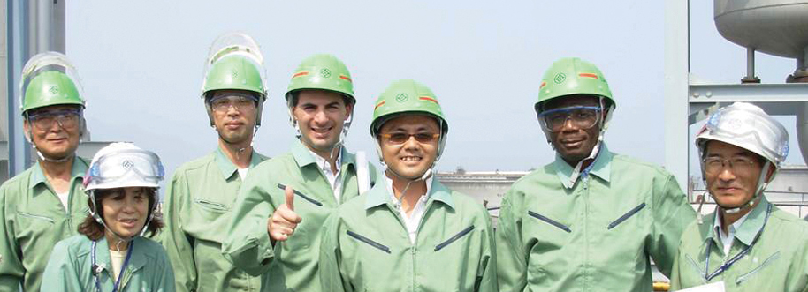
Safety Training Program

Slide 19
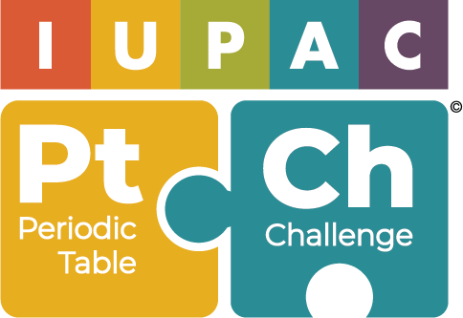
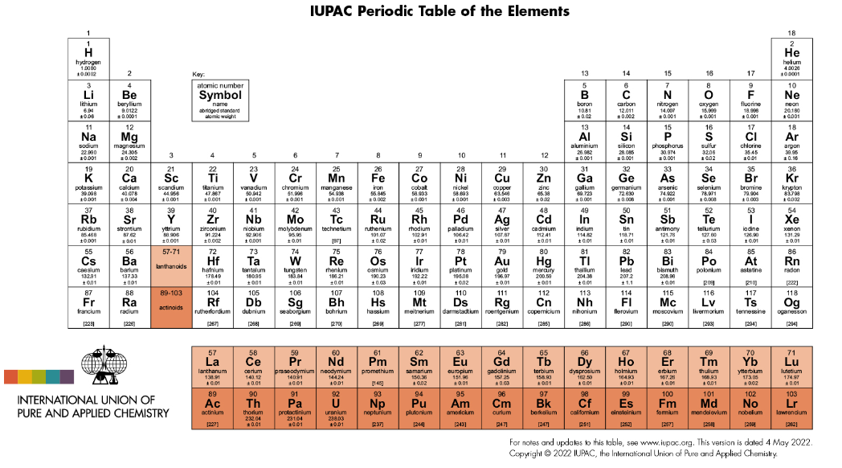
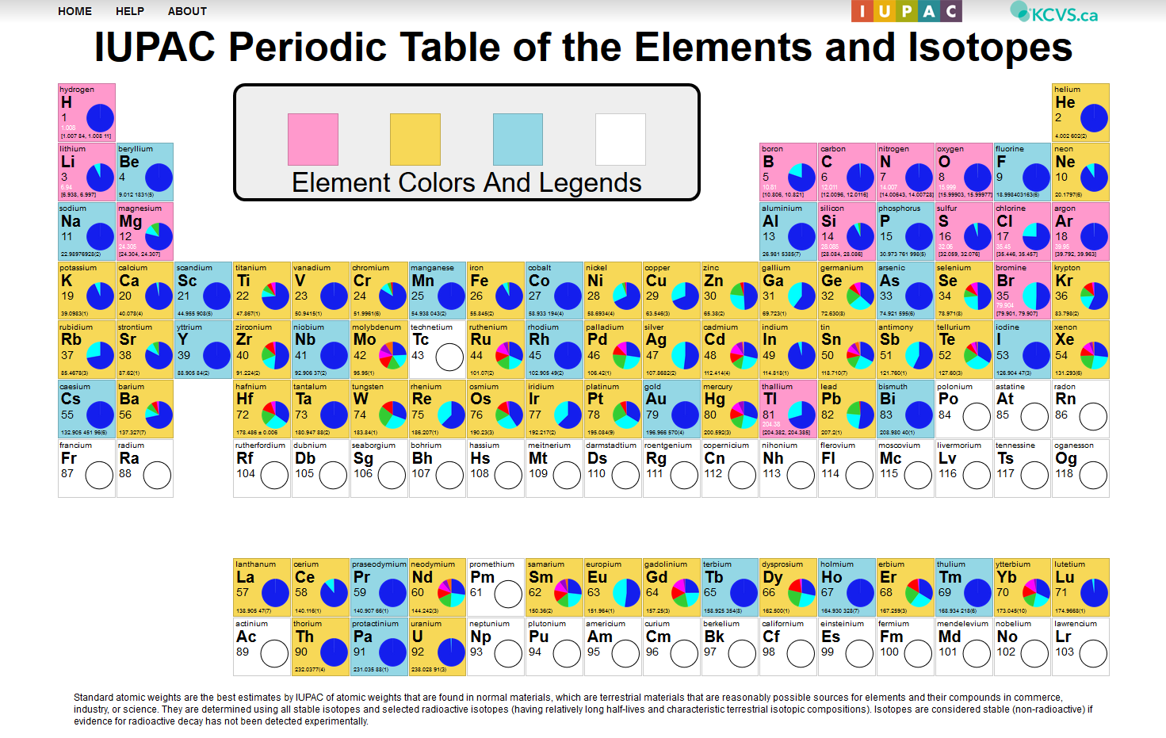
Educational Tools
iupac.org/what-we-do/periodic-table-of-elements
iupac.org/periodic-table-challenge
applets.kcvs.ca/IPTEI/IPTEI.html

Slide 20
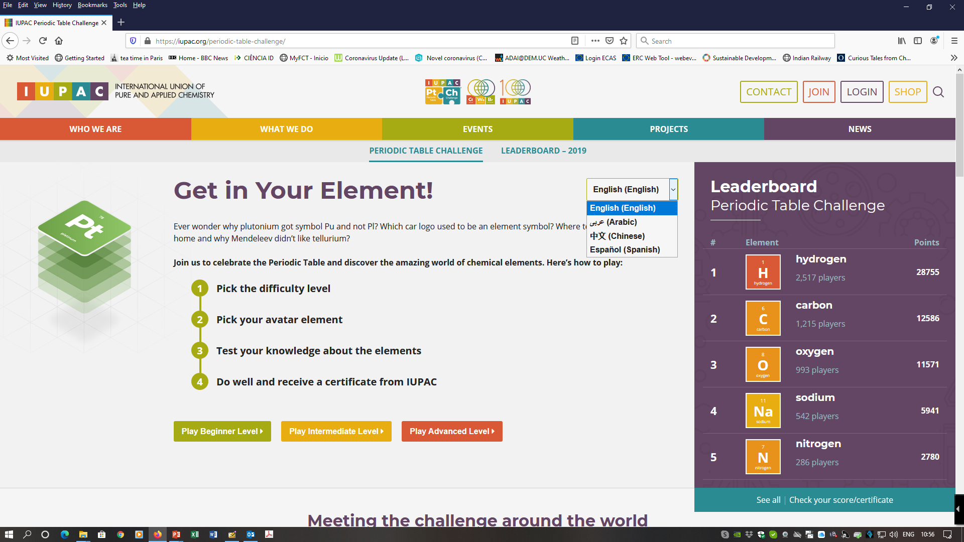

Slide 21
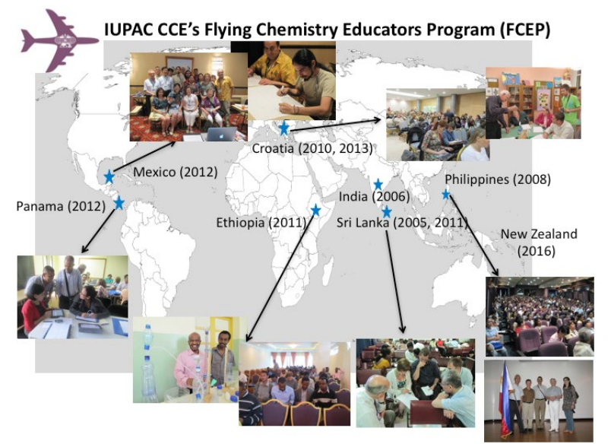
Educators Program

Slide 22
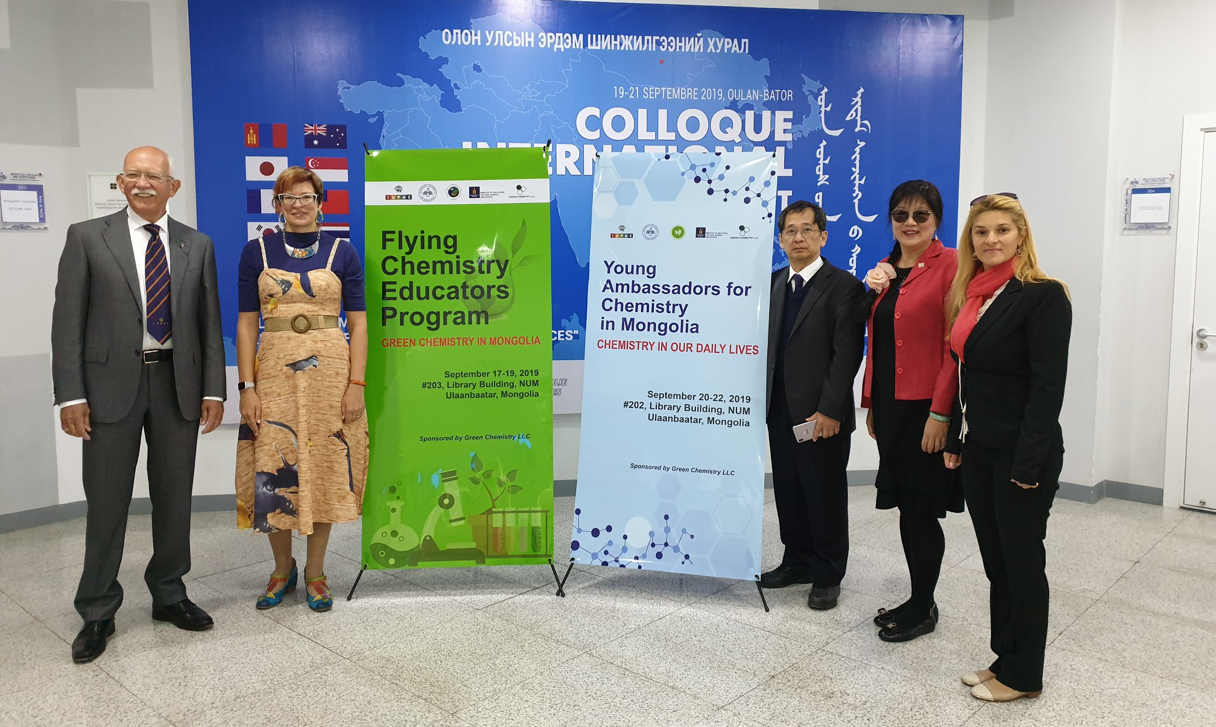

Slide 23
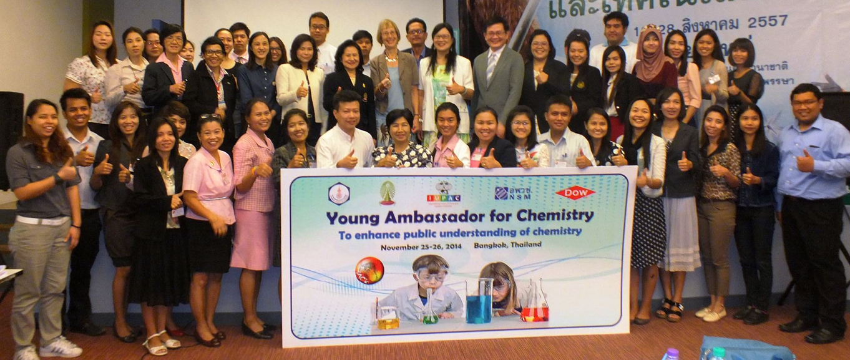
Young Ambassador for Chemistry

Slide 24
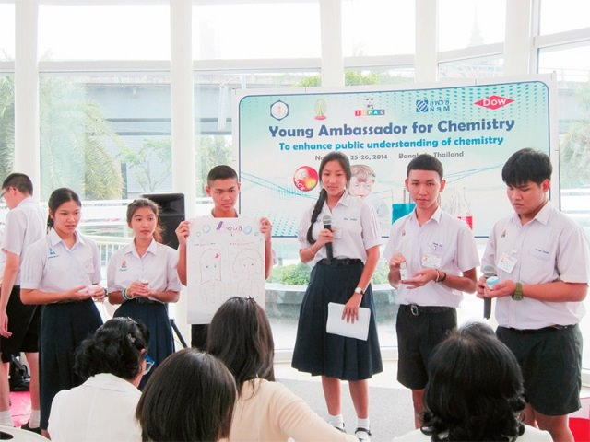


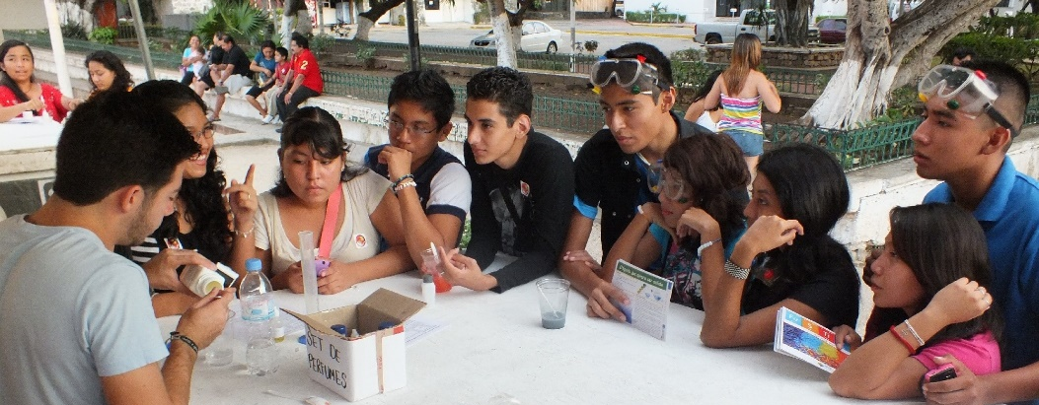

Slide 25
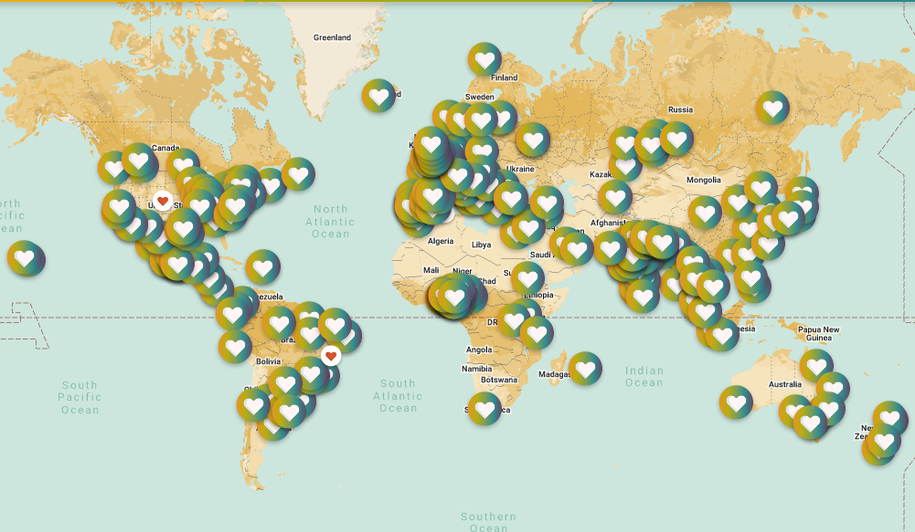

Global Woman Breakfast
In 2024
420 events
in 77 countries
est. 40,000 participants
Notes:
Outreach

Slide 26
IUPAC Scientific Activities
Setting and Recommending “Standards”
Publishing
Honoring
Building
Worldwide
Capacity
Sharing Emerging Science
Networking
Journals
Books
Databases
Awards to honor Scientific Contributions and Expertise
Nomenclature, Terminology and Symbols (Recommendations & Report)
Periodic Table of Elements
Isotopic Abundance
Guides in Metrology
Safety Training
Education
Outreach
Top 10 Emerging Technologies in Chemistry
Endorsement of Symposia and Int. Conferences
Notes:
publishing of technical reports, journals, books, databases and other information resources that facilitate the conduct of scientific research
NEXT conferences,
IUPAC is also involved in joint projects with other organizations; for example the Joint Committee for Guides in Metrology (JCGM) or the Office for the Prohibition of Chemical Weapons (OPCW).

Slide 27
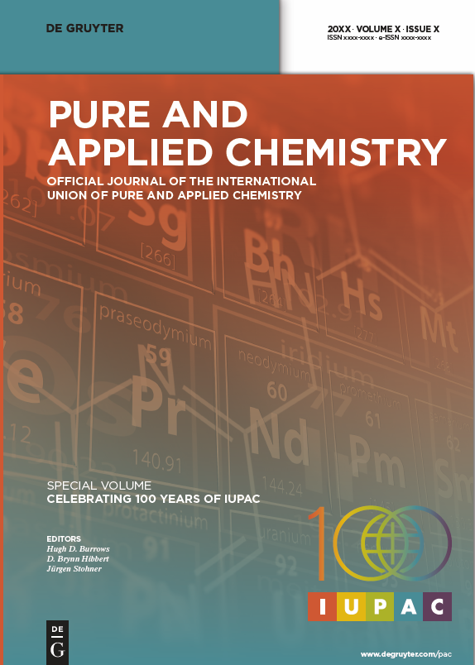
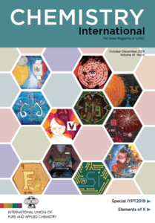
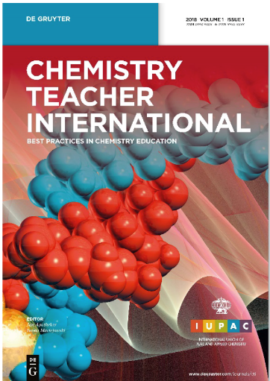
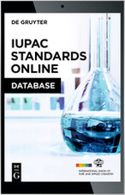
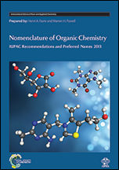
IUPAC Publications & Databases
Notes:
What does IUPAC do?
The International Union of Pure and Applied Chemistry (IUPAC) is the world authority on chemical nomenclature, terminology (including the naming of new elements in the periodic table), standardized methods for measurement, atomic weights and many other critically-evaluated data. It develops and maintains Recommendations that create a common language for the global chemistry community. The scientific work of IUPAC is conducted largely through a formal Project System in which proposals from chemists around the world are peer-reviewed and, if meritorious, are approved and supported. In addition, IUPAC has many other wide-ranging activities that ultimately impact both the chemical profession and the worldwide community as a whole. These include the publishing of technical reports, journals, books, databases and other information resources that facilitate the conduct of scientific research, conferences, and the provision of awards for the recognition of scientific excellence. IUPAC is also involved in joint projects with other organizations; for example the Joint Committee for Guides in Metrology (JCGM) or the Office for the Prohibition of Chemical Weapons (OPCW). In recent years, IUPAC has become active is setting up networks of chemists with common interests (eg. chemical education in developing countries, green chemistry and sustainability)

Slide 28
IUPAC Scientific Activities
Setting and Recommending “Standards”
Publishing
Honoring
Building
Worldwide
Capacity
Sharing Emerging Science
Networking
Journals
Books
Databases
Awards to honor Scientific Contributions and Expertise
Nomenclature, Terminology and Symbols (Recommendations & Report)
Periodic Table of Elements
Isotopic Abundance
Guides in Metrology
Safety Training
Education
Outreach
Top 10 Emerging Technologies in Chemistry
Endorsement of Symposia and Int. Conferences
Notes:
facilitate the conduct of scientific research, conferences,
is also involved in joint projects with other organizations; for example the Joint Committee for Guides in Metrology (JCGM) or the Office for the Prohibition of Chemical Weapons (OPCW).
In recent years, IUPAC has become active is setting up networks of chemists with common interests (eg. chemical education in developing countries, green chemistry and sustainability)

Slide 29

53rd IUPAC General Assembly (11-15 August 2025) and the 50^{h} IUPAC World Chemistry Congress (13-18 August 2025)
Chemistry for Sustainable Future
iupac2025.org

Slide 30
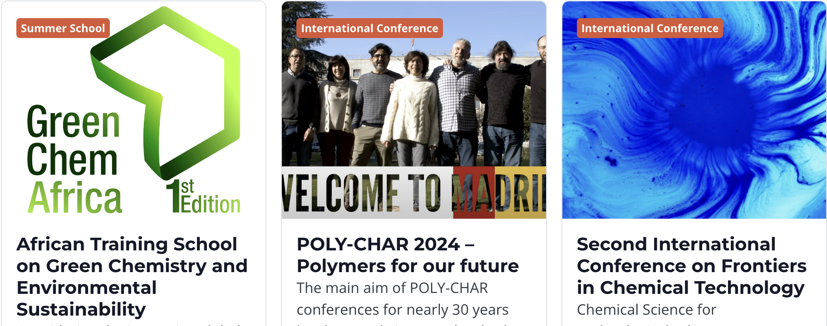
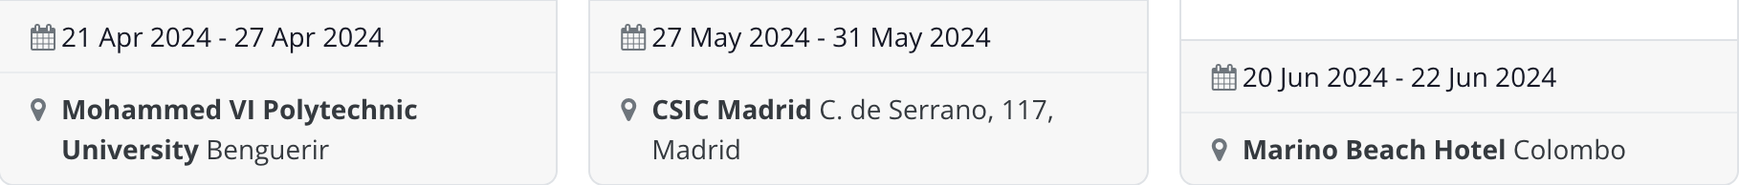
IUPAC Endorsed Conferences and Meetings
About 20 to 25 events endorsed per Year
Notes:
\

Slide 31
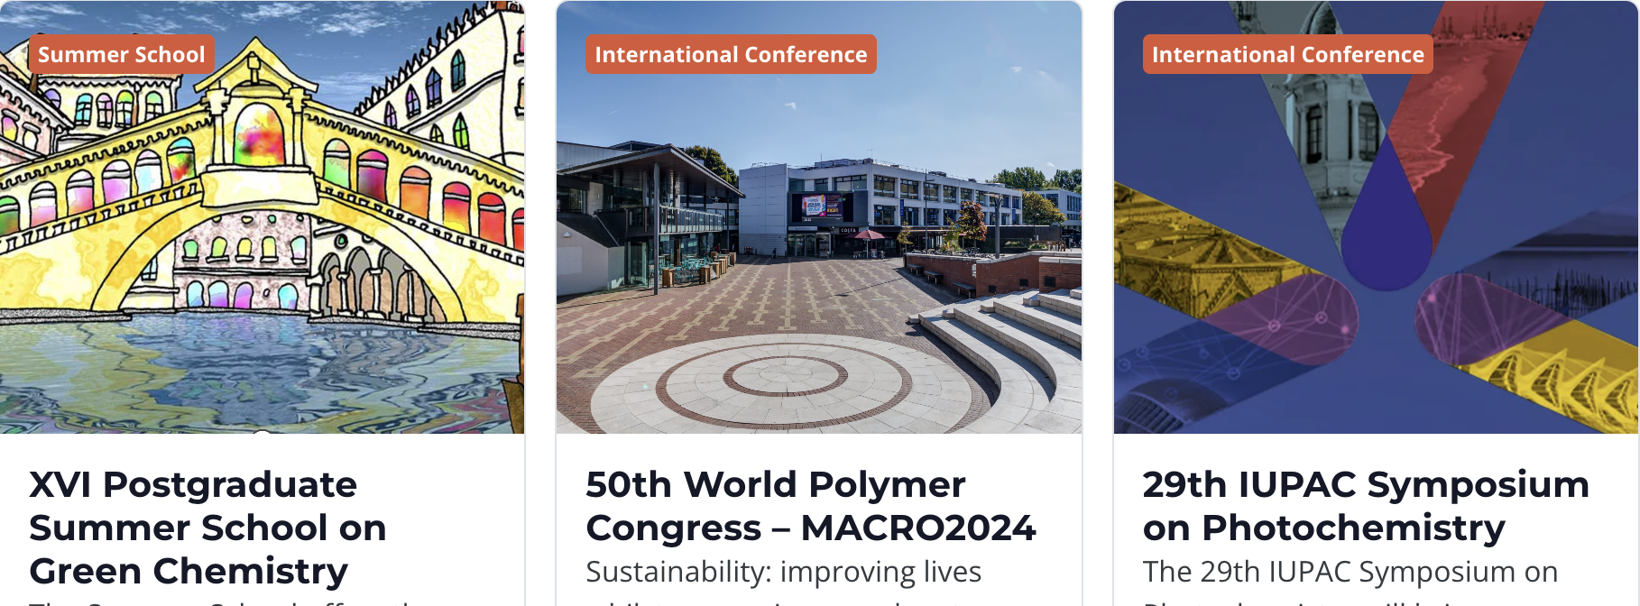
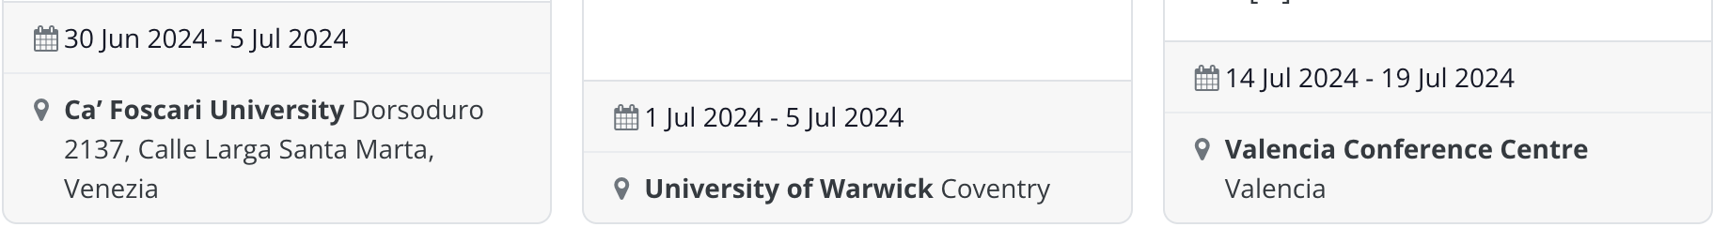
IUPAC Endorsed Conferences and Meetings

Slide 32

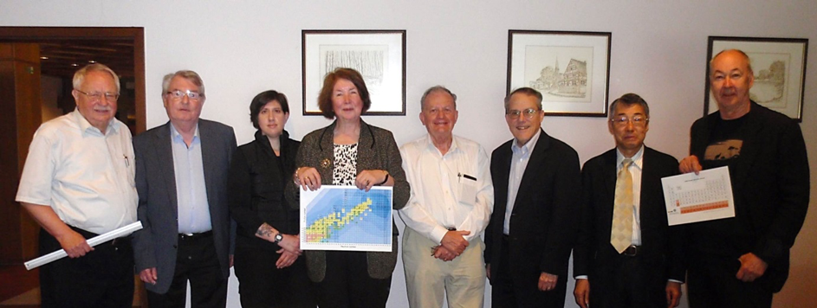


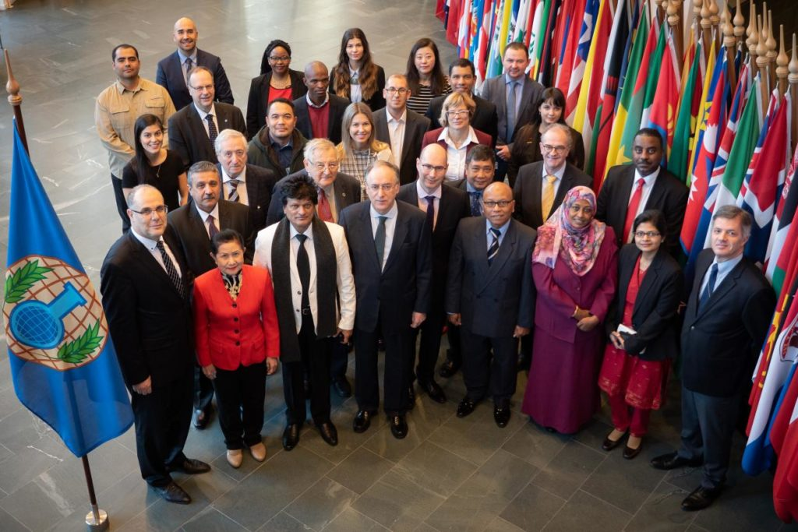
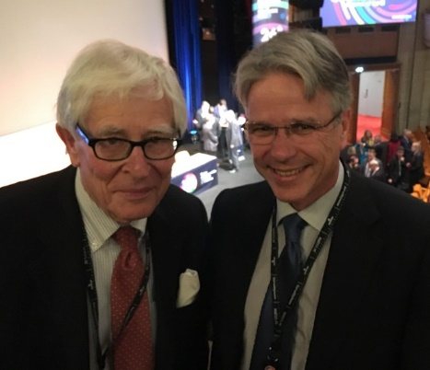
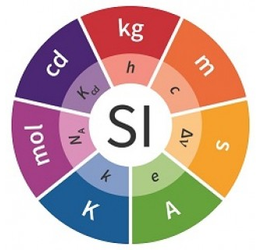
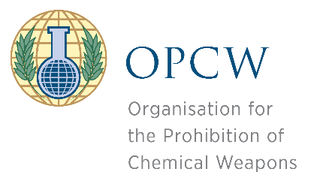

Collaboration with International Organizations

Slide 33

Collaboration with International Organizations
Partner in ISC “Gender Gap in Science” Project
https://gender-gap-in-science.org/

Slide 34
IUPAC Scientific Activities
Setting and Recommending “Standards”
Publishing
Honoring
Building
Worldwide
Capacity
Sharing Emerging Science
Networking
Journals
Books
Databases
Awards to honor Scientific Contributions and Expertise
Nomenclature, Terminology and Symbols (Recommendations & Report)
Periodic Table of Elements
Isotopic Abundance
Guides in Metrology
Safety Training
Education
Outreach
Top 10 Emerging Technologies in Chemistry
Endorsement of Symposia and Intl. Conferences
Notes:
the provision of awards for the recognition of scientific excellence.

Slide 35
Scientific Awards Programs
IUPAC-Solvay International Award for Young Chemists
Distinguished Women in Chemistry or Chemical Engineering
Thieme-IUPAC Prize
Hanwaha-Total IUPAC Young Scientist Award | Polymer International-IUPAC Award | Stepto Lecture Award
Analytical Chemistry Awards | Franzosini Prize | Balarew Award
IUPAC International Award for Advances in Crop Protection Chemistry
IUPAC-Richter Prize in Medicinal Chemistry
CHEMRAWN VII Prize for Green Chemistry
IUPAC- Zhejiang NHU International Award for Advancements in Green Chemistry
Chemistry Education Awards
ThalesNano Prize for Flow Chemistry | PhosAgro/UNESCO/IUPAC Green Chemistry for Life Grants Program

Slide 36
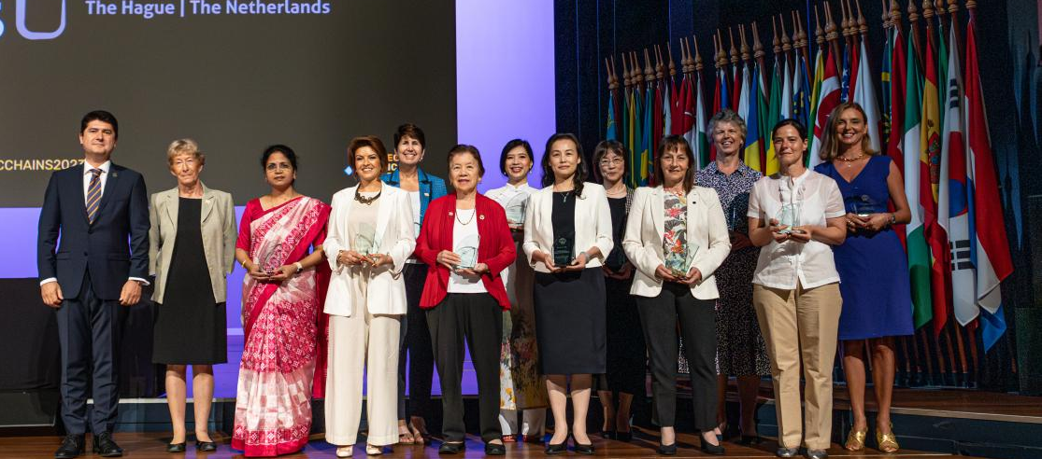
IUPAC Works to Empower Diversity in Science
Distinguished Women in Chemistry and Engineering Awards
Notes:
provision of awards for the recognition of scientific excellence.

Slide 37


iupac.org/100/stories/

Slide 38
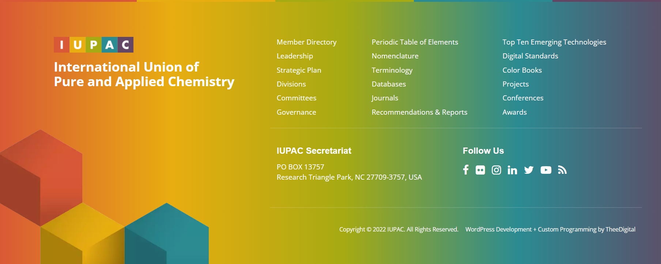


Thank You
&
hope to see you soon

